Slide 1




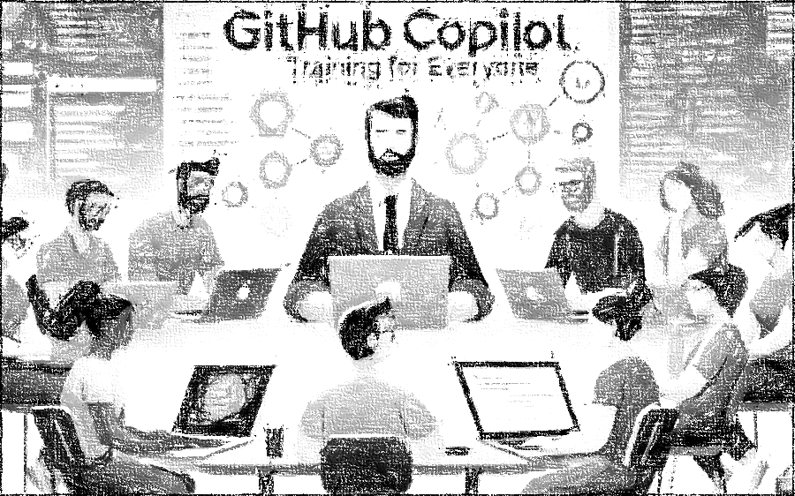


GitHub Copilot for Almost Everyone
Tim Warner
timw.info/linkedin
Notes:
How much flexibility am I allowed with these slide layouts? If you right-click a slide, you can play with layouts, but otherwise, not much flexibility.
Am I free to add my own graphics, providing MSFT attribution where necessary? When it comes to MS graphics, we're not allowed to use those, so please do not add in graphics unless they are created FROM SCRATCH by you.
Can I make the font a bit smaller? Some of the objectives are verbose and I don’t want to crowd the skills? Yes, I do this, too, when I review the slides because sometimes the default size just won't work.
Do the bullet points here need to be word-for-word from the outline or can I condense? We prefer word-for-word, but some of the sub-lesson titles are super long. Use your discretion, and we can address case-by-case during the review of each lesson's slides.

Slide 2

Tim Warner
Based in Nashville, TN, US
Microsoft tech specialist and trainer since 1997 (Windows NT 4.0)
Microsoft Certified Trainer (MCT)
Microsoft MVP in Azure AI & Cloud/Datacenter Management
Contact: TechTrainerTim.com

Slide 3
Course Flow (Central Time Zone)
09:00 am - Start - Segment 1 [Secure Your Foundation]
10:00 am - 10-minute break - Segment 2 [LLM Deployment Patterns]
11:00 am - 10-minute break - Segment 3 [Copilot + IaC Velocity]
12:00 pm - 10-minute break - Segment 4 [Ops, Governance, Future]
01:00 pm - Finish

Slide 4
Course materials
timw.info/eai

Slide 5
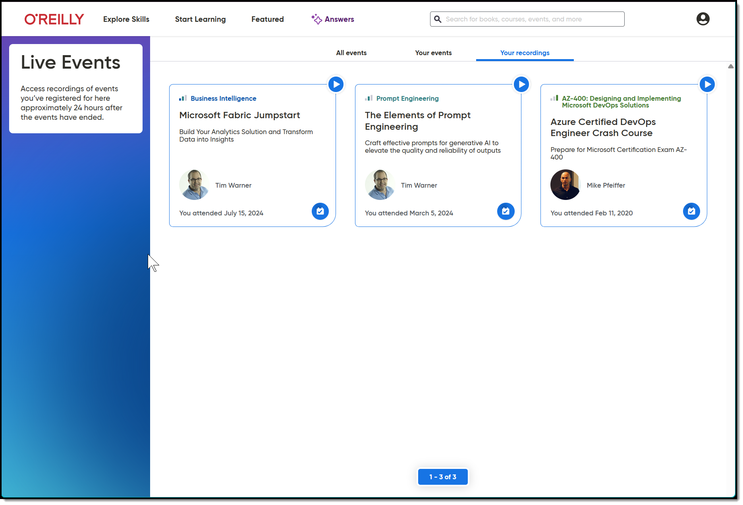
Session Recording + Badge

Slide 6
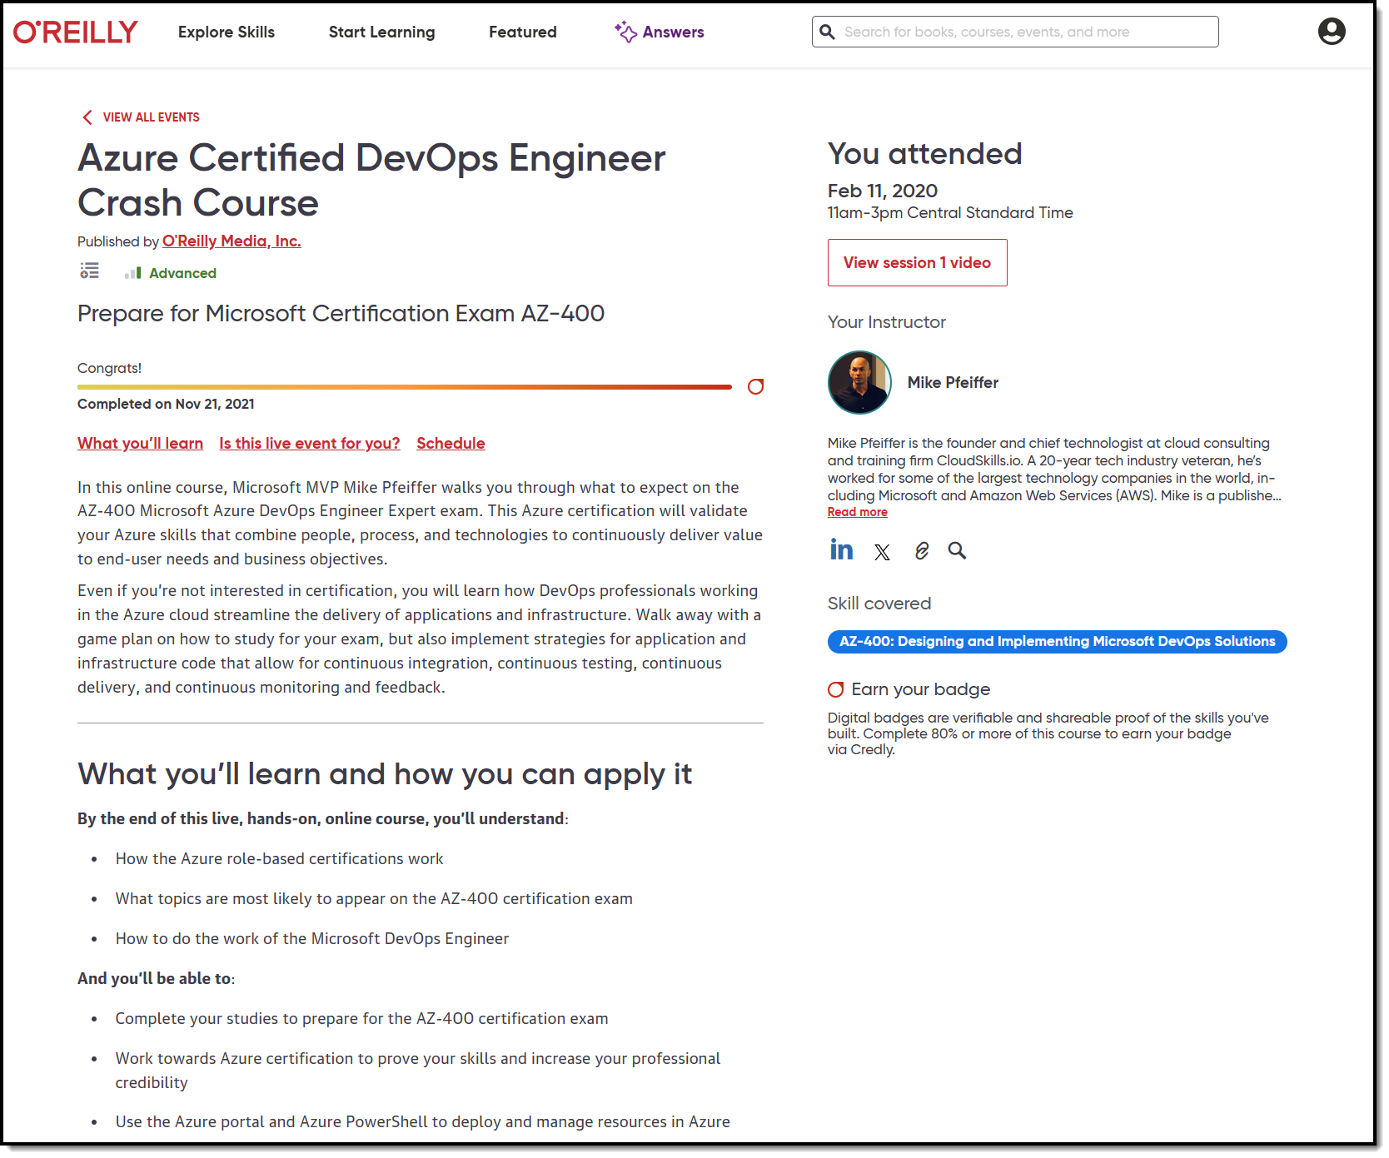
Session Recording + Badge

Slide 7
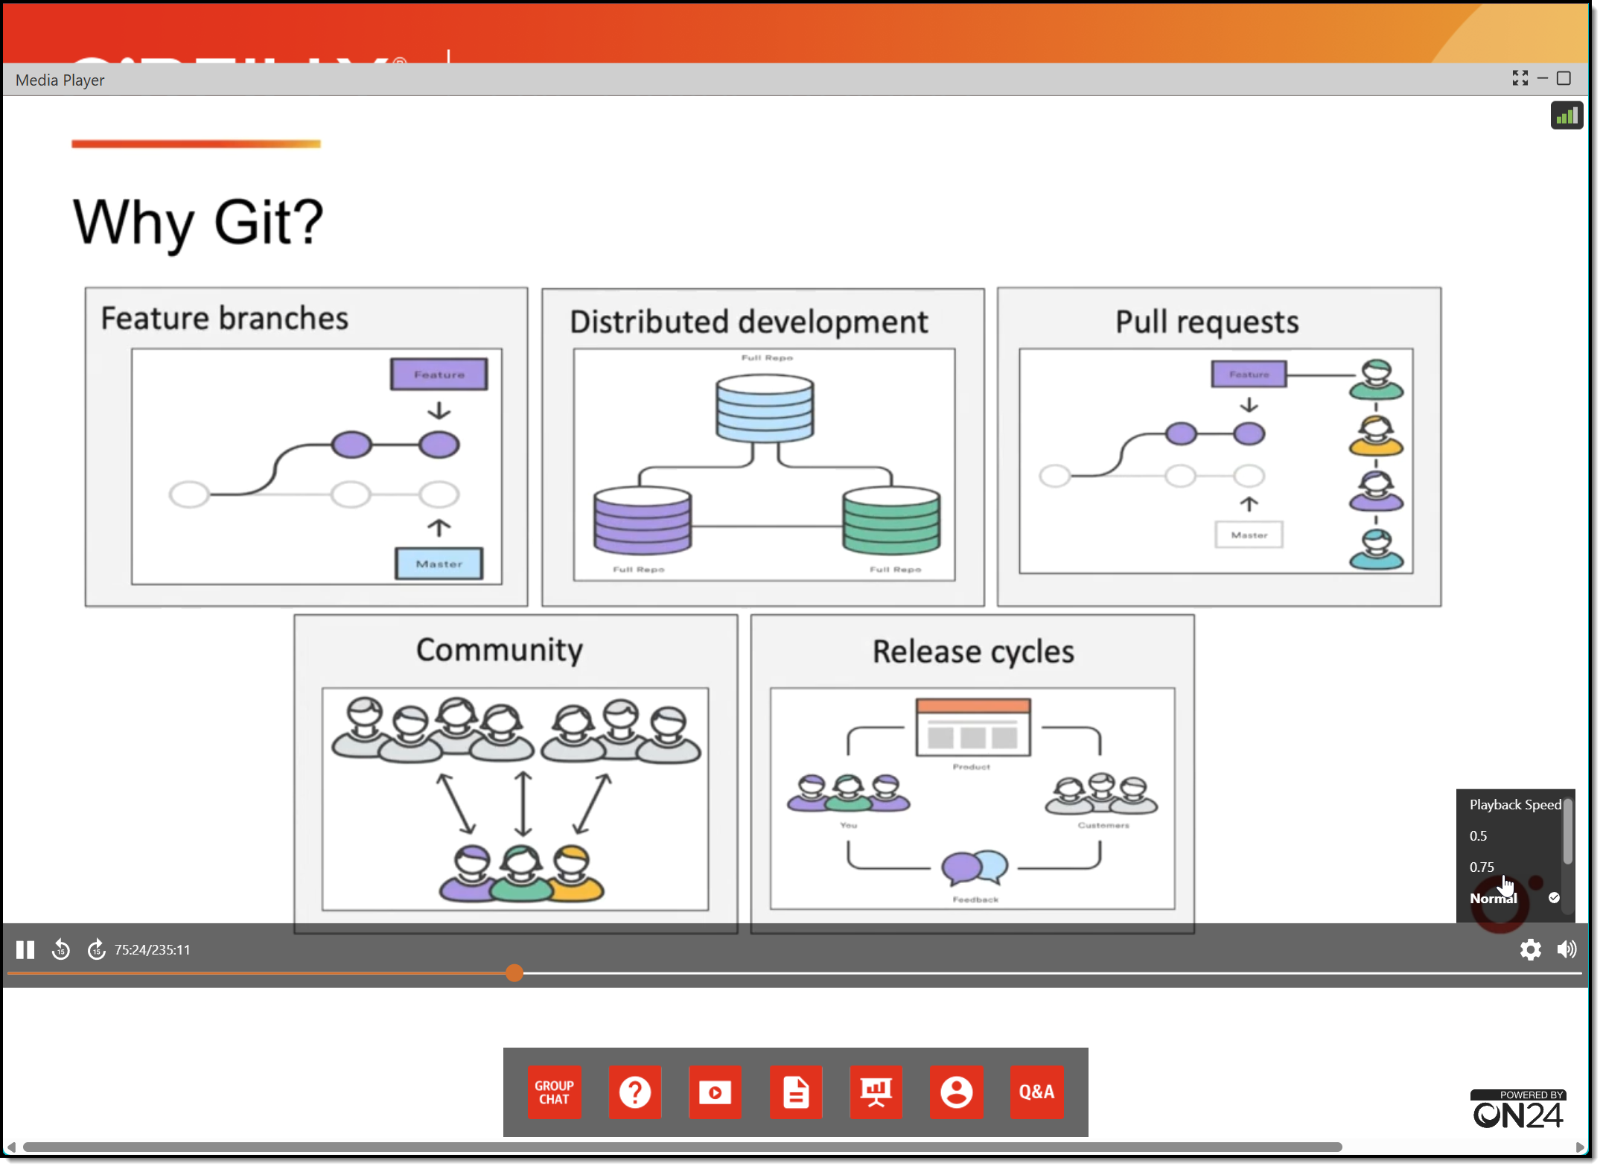
Session Recording + Badge

Slide 8
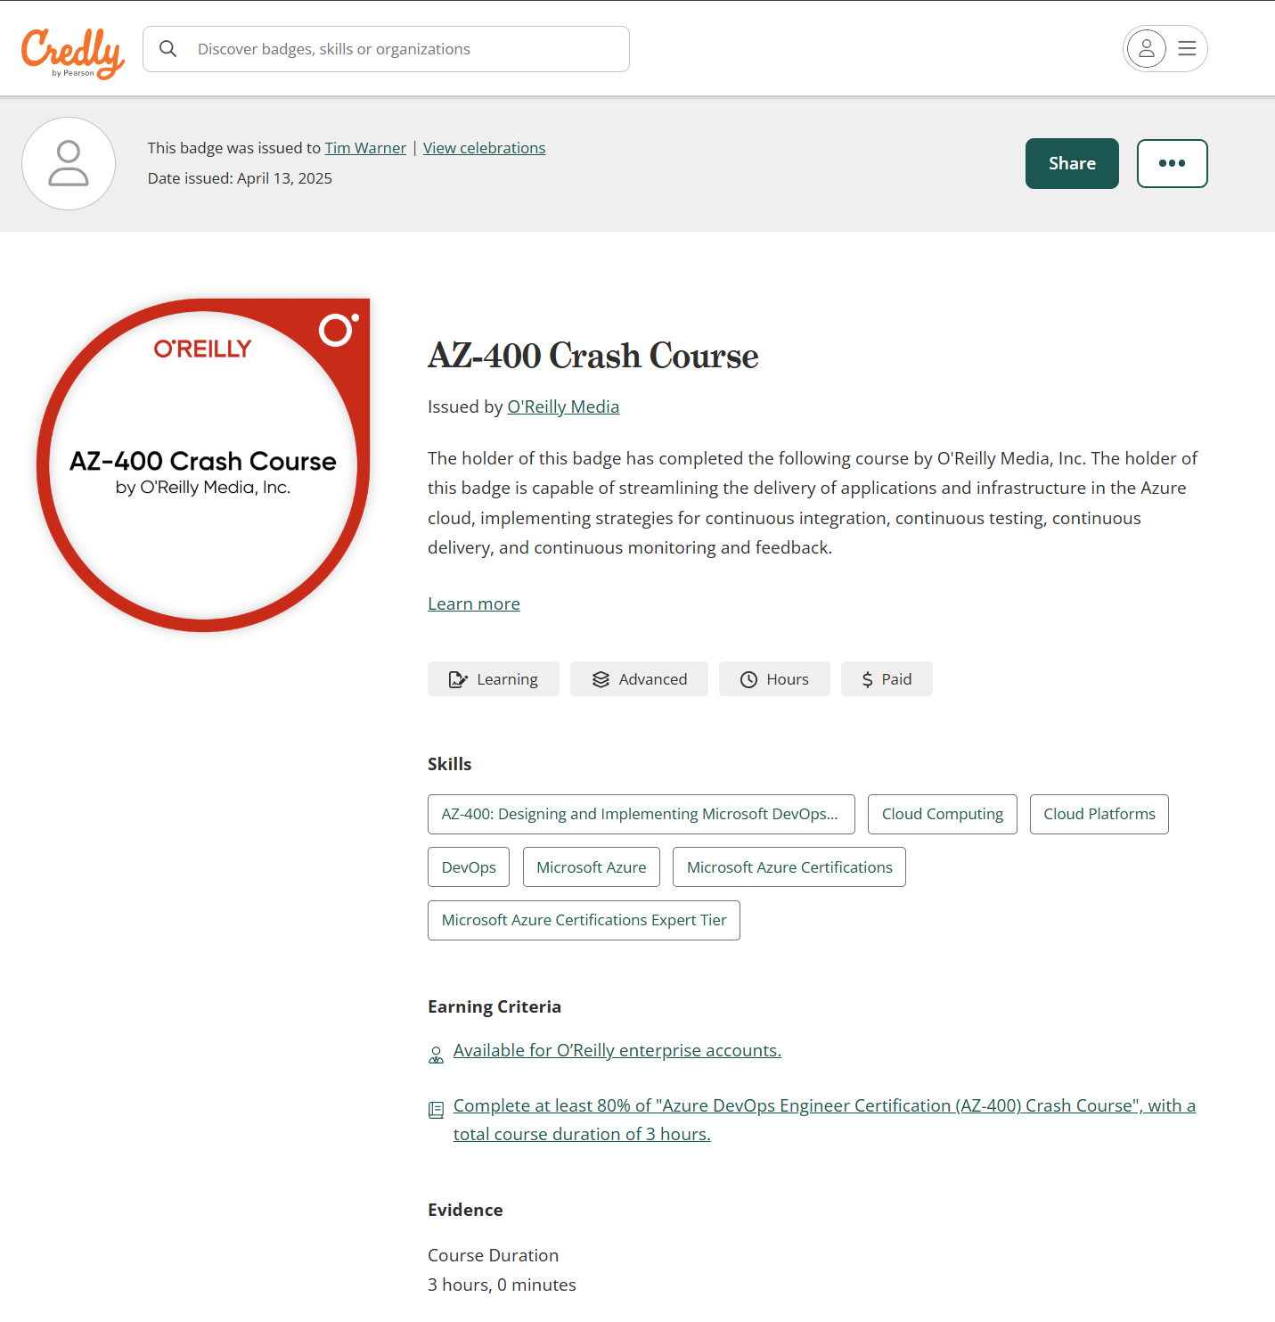
Session Recording + Badge

Slide 9
Thank you!
Course materials: timw.info/eai
Contact: TechTrainerTim.com

Slide 10
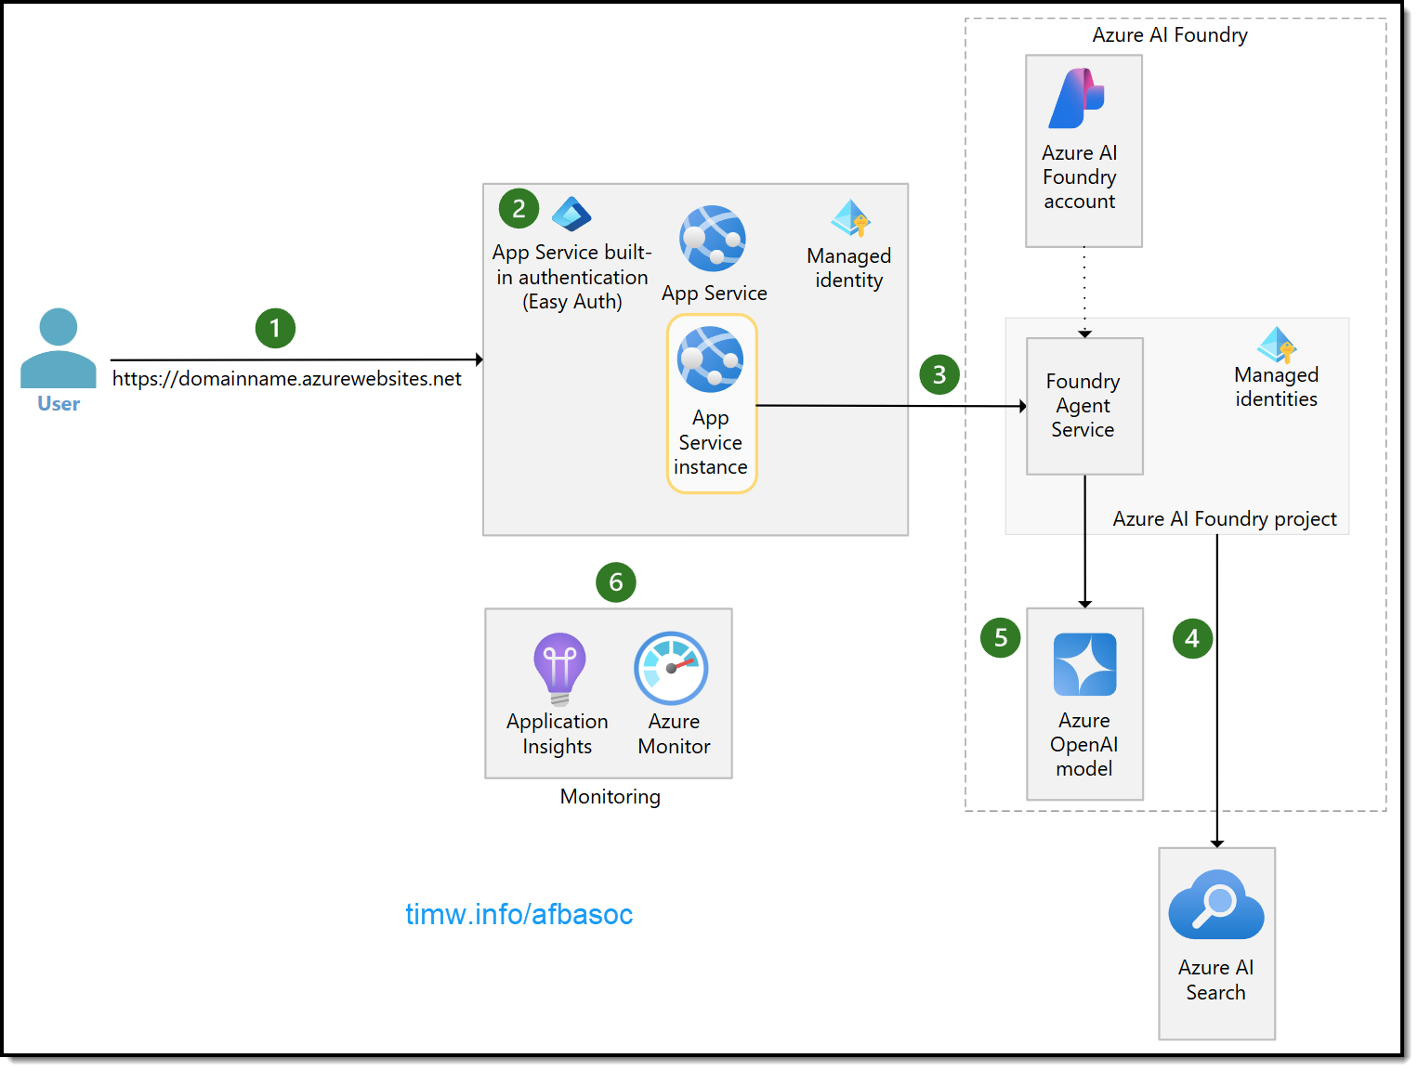

Slide 11
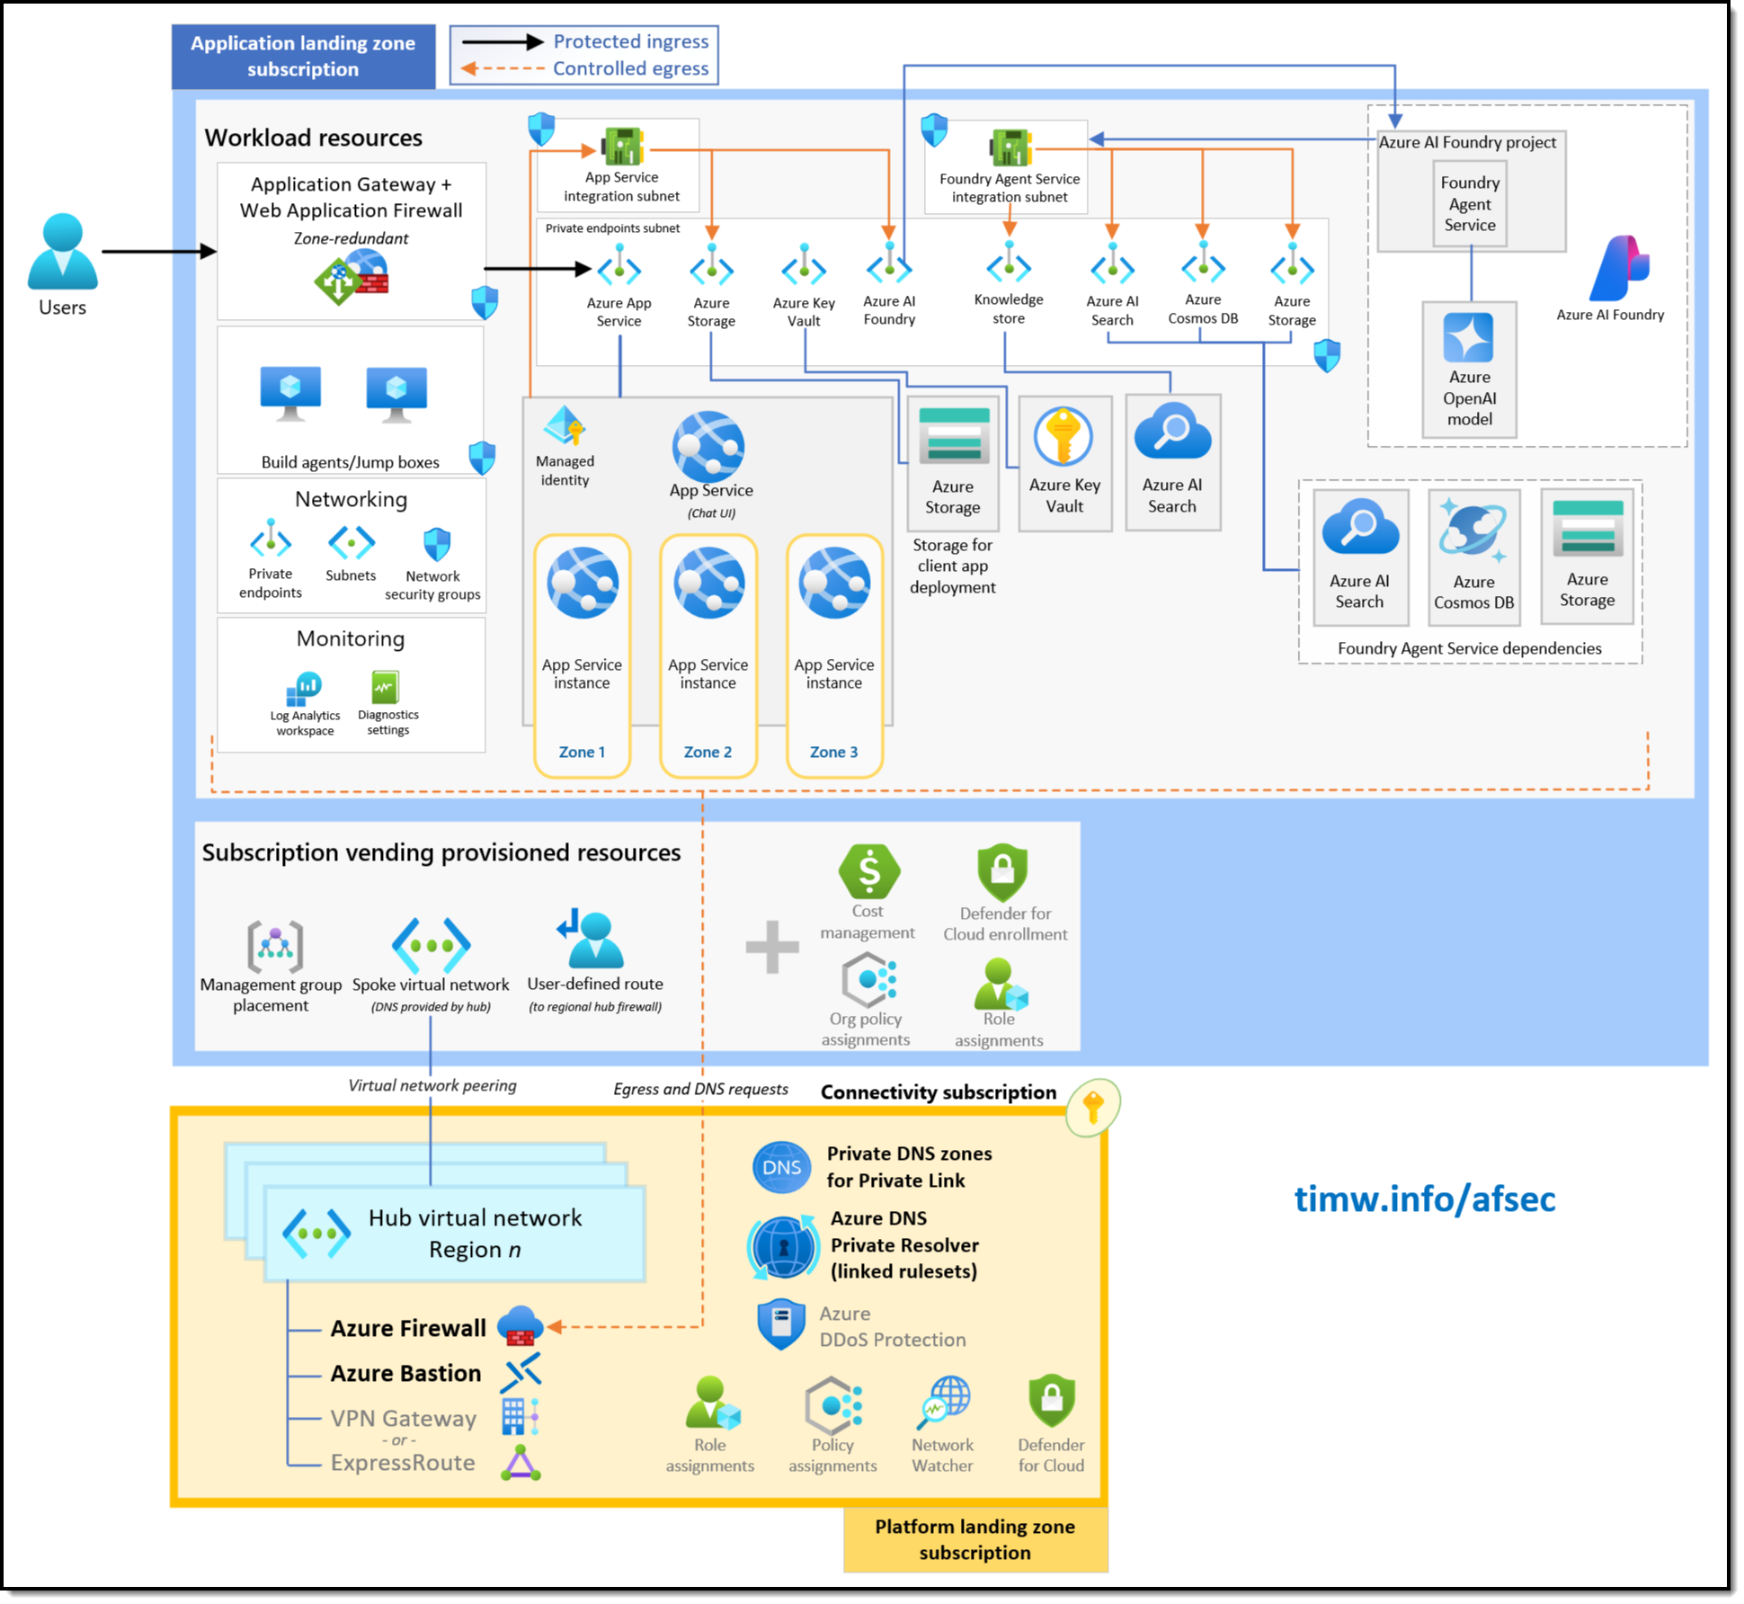

Slide 12
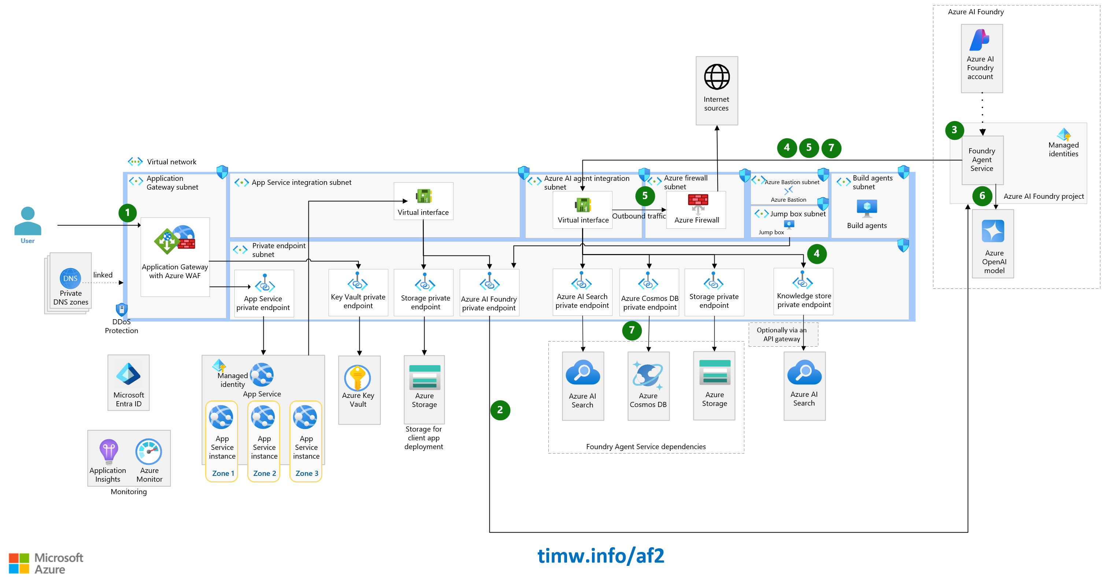

Slide 14
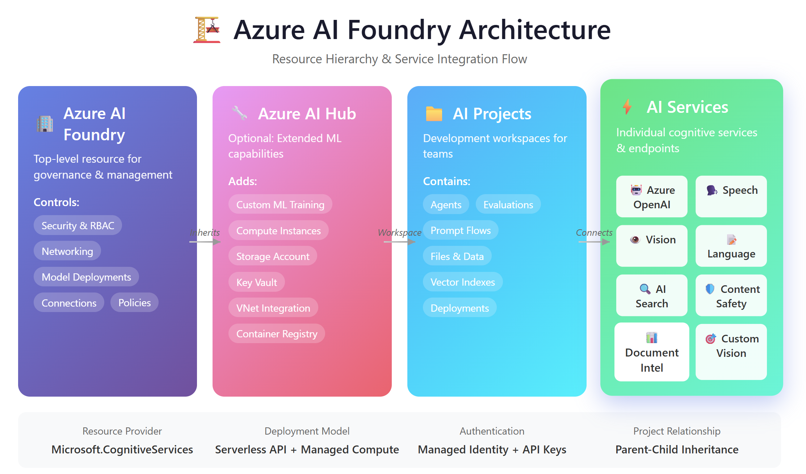

Slide 15
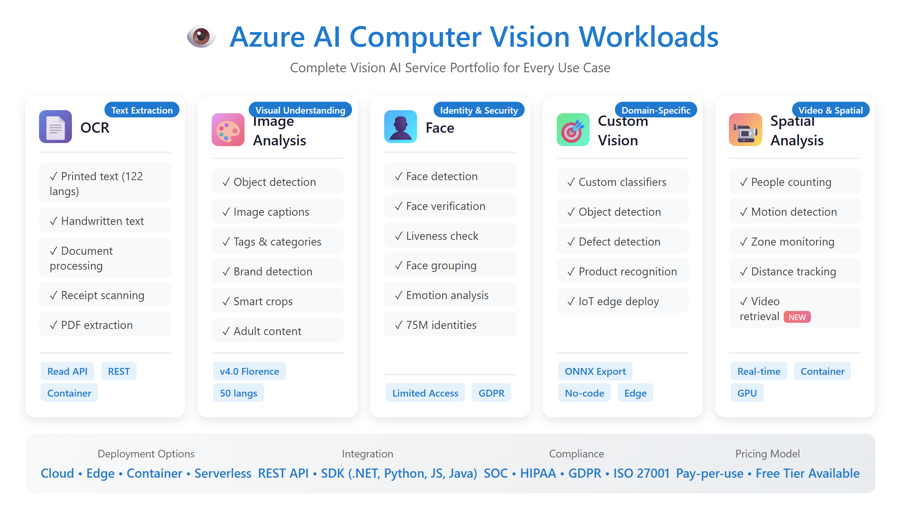

Slide 16
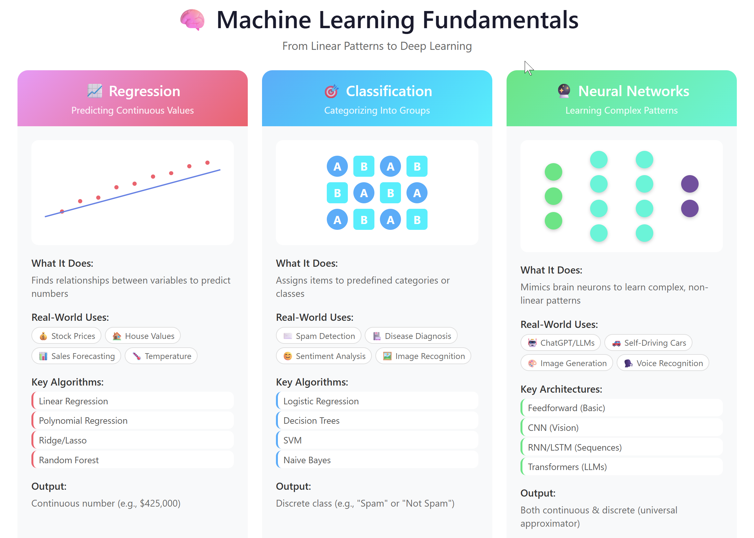

Slide 17
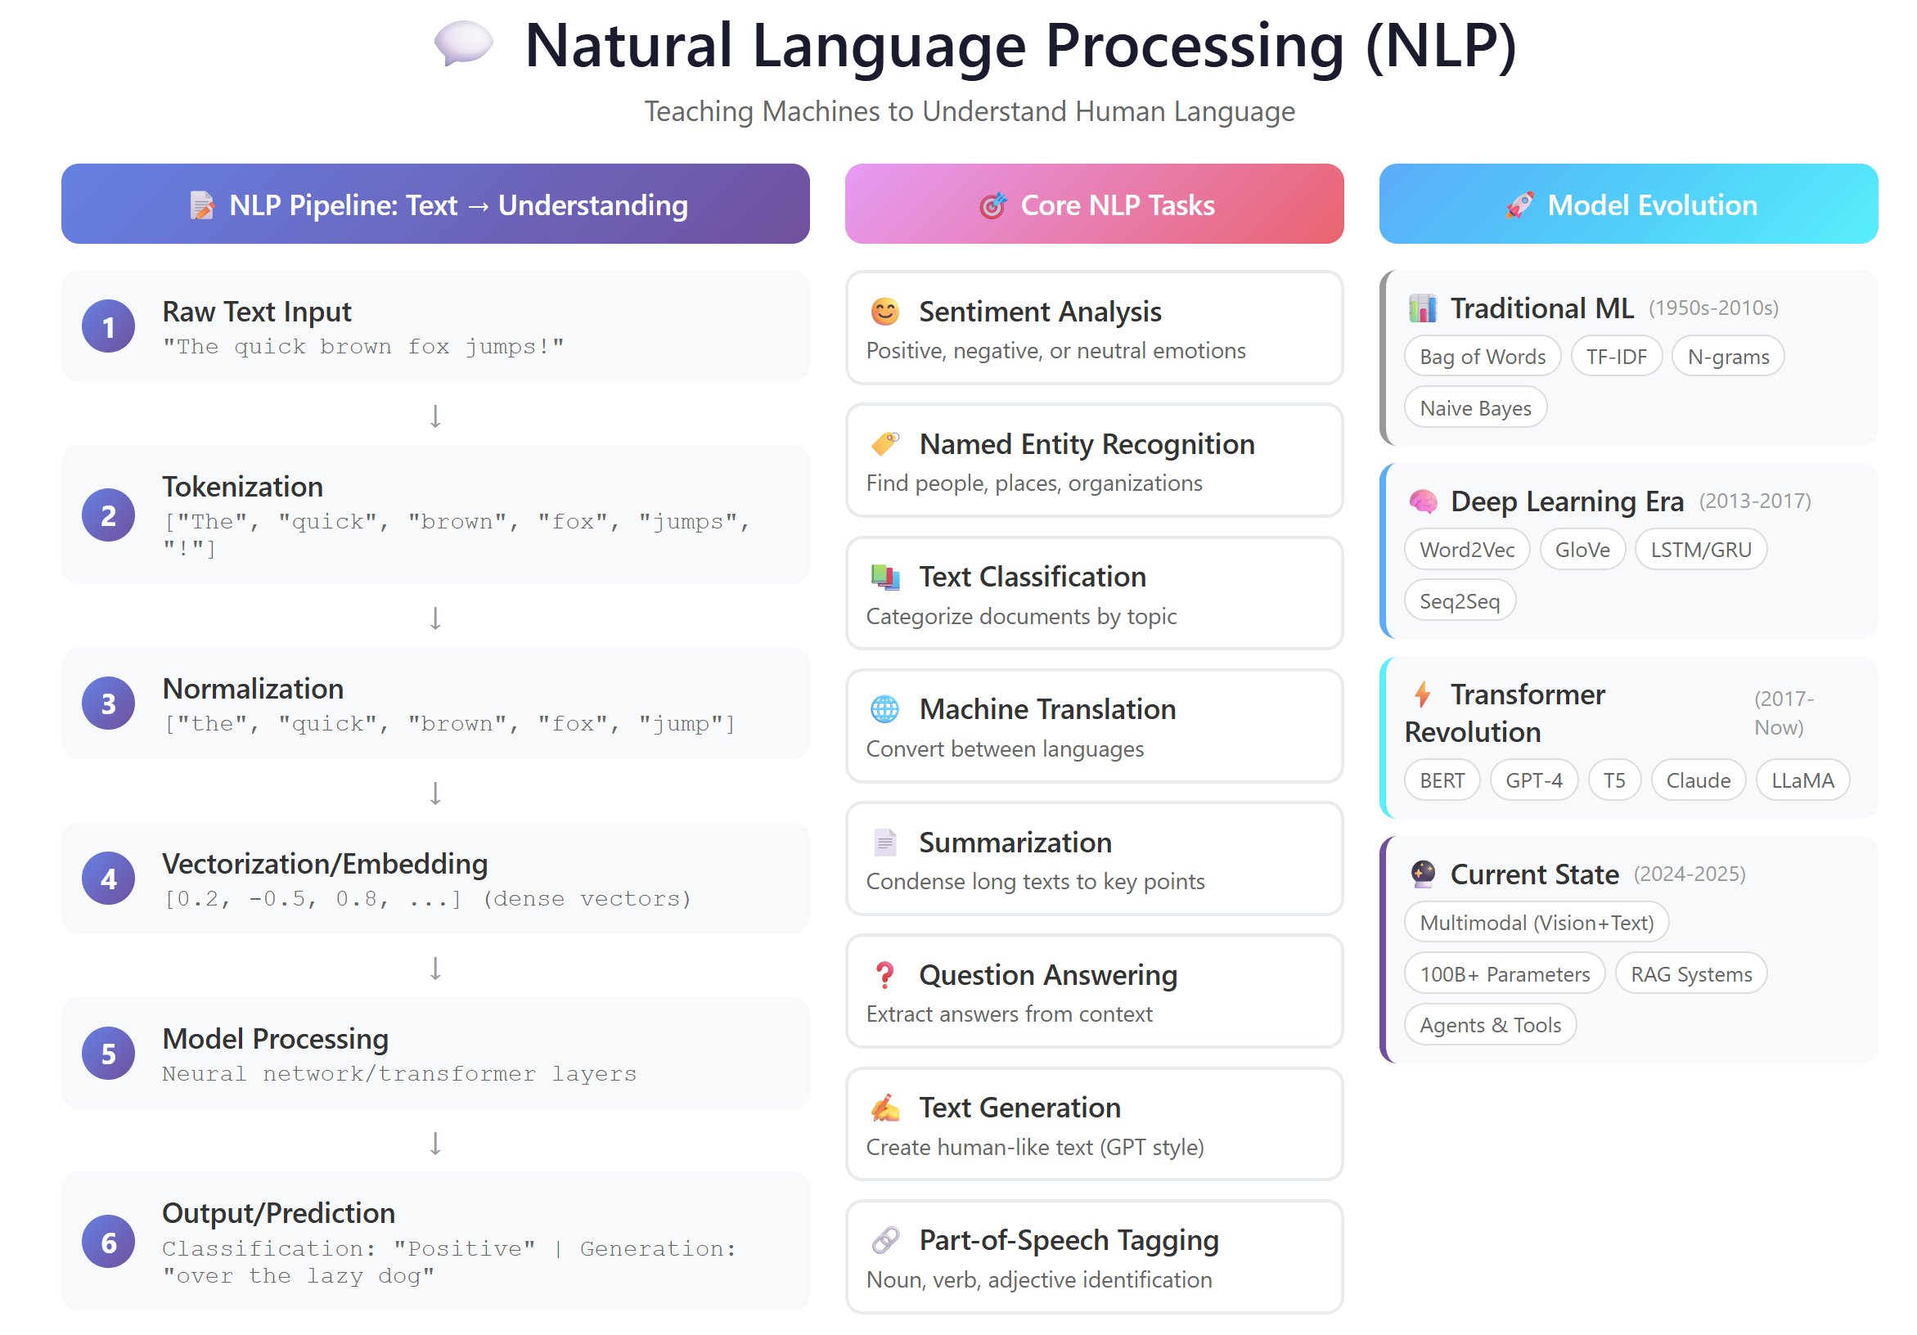

Slide 18
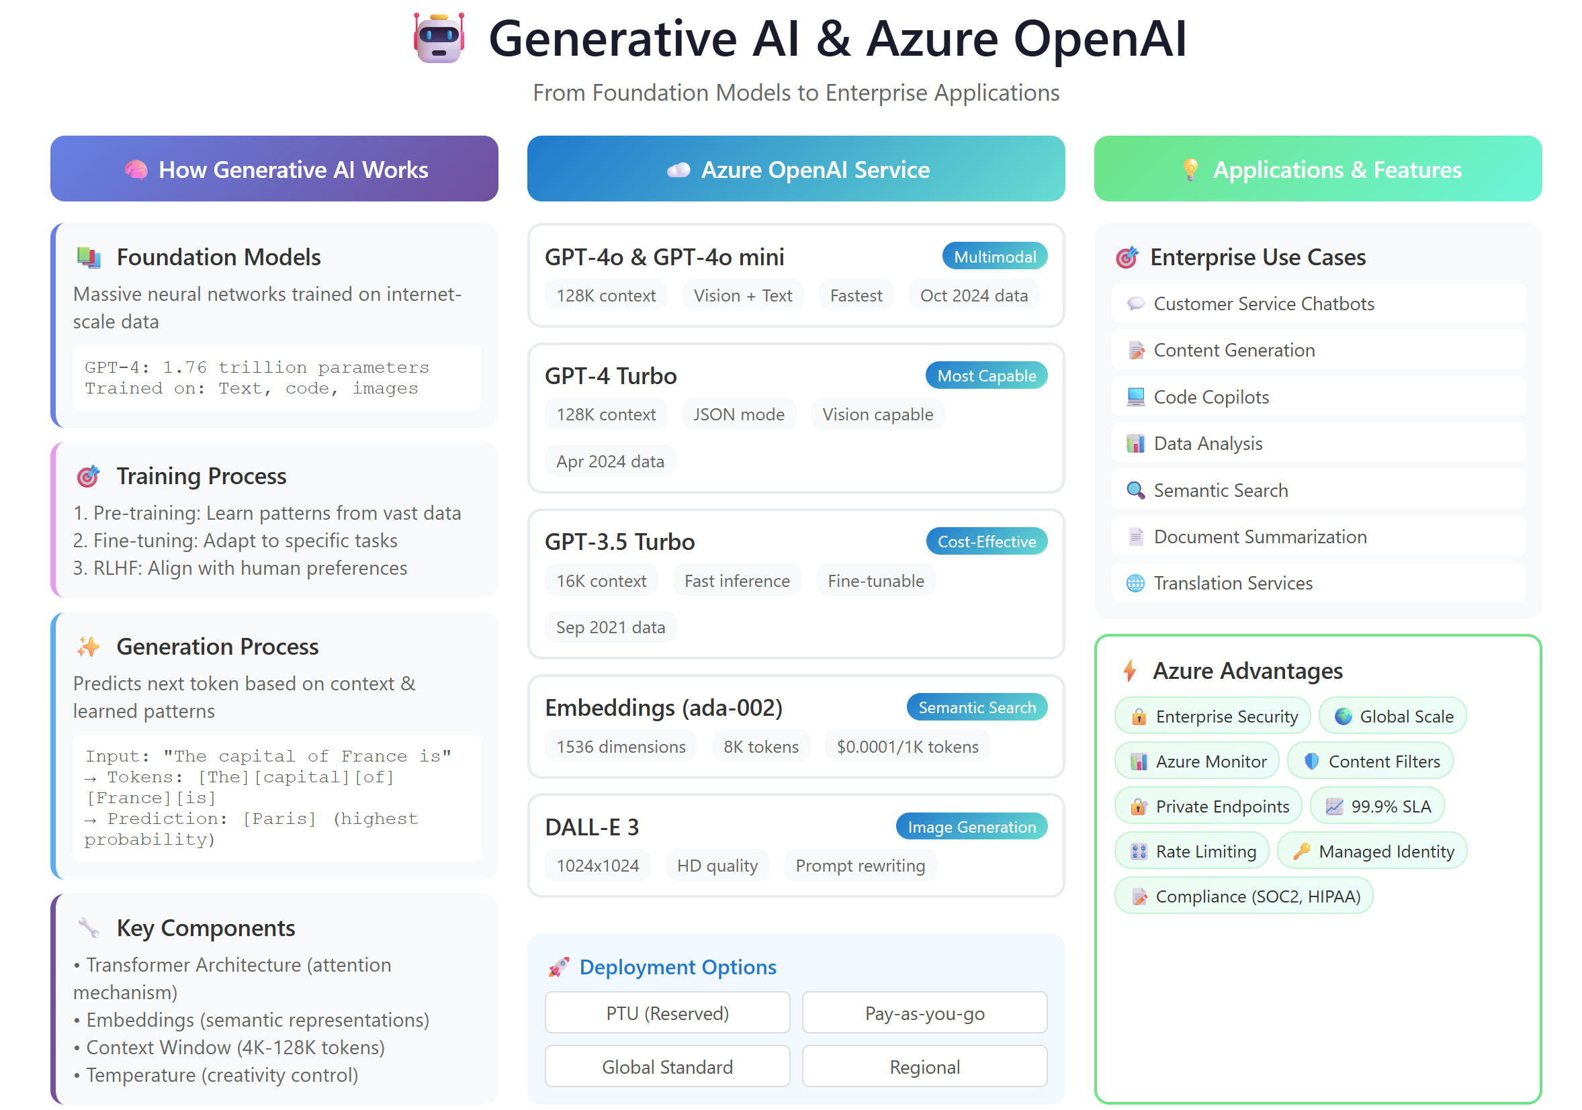

Slide 19
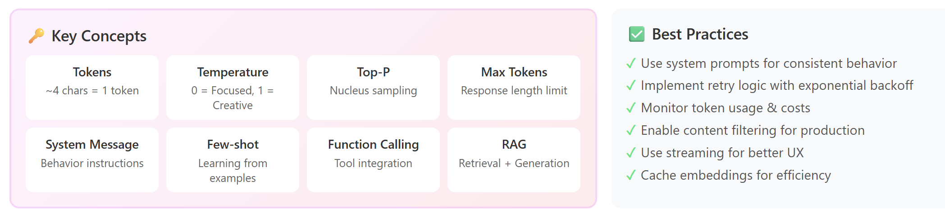

Slide 20
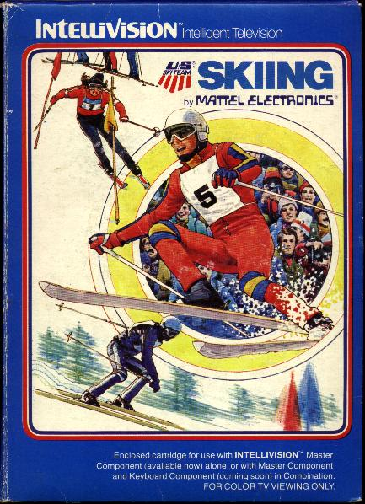
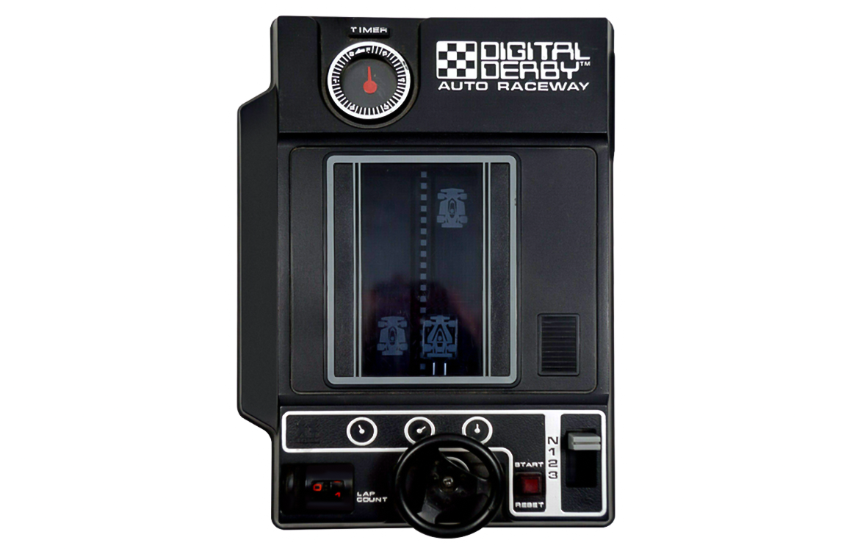

Keeping an LLM on task be like…

Slide 21
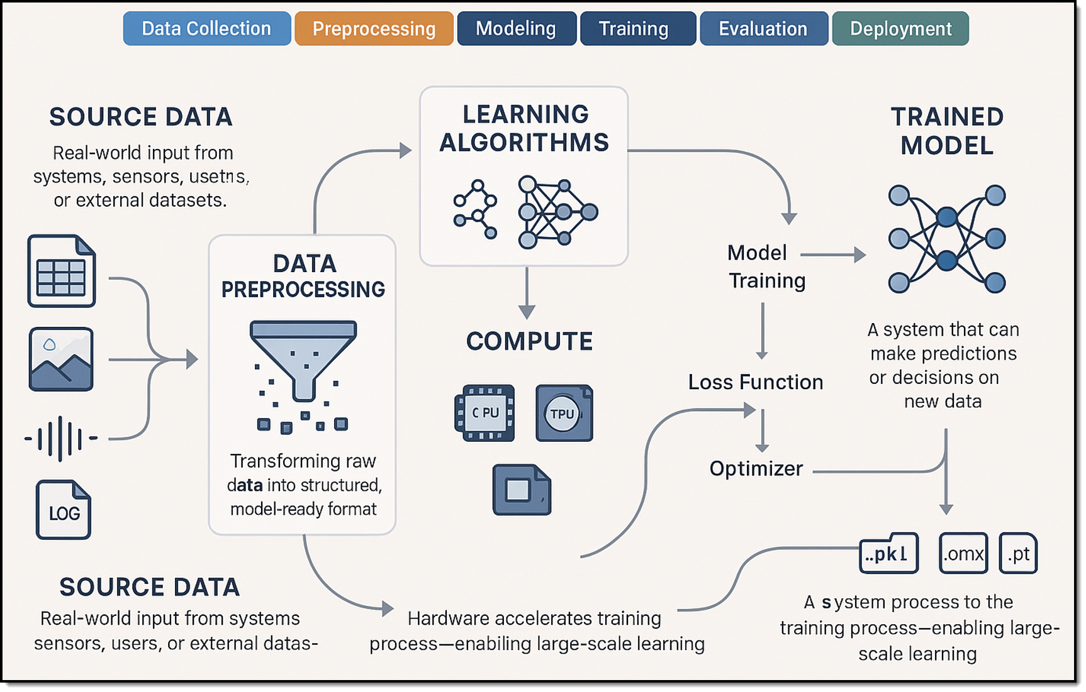
Machine Learning (ML) lifecycle
Notes:
I generated the image with my prompt in my personal ChatGPT account using their latest image-gen model. Did that on Wed, 3/26/2025 at 3pm Central or thereabouts.

Slide 22
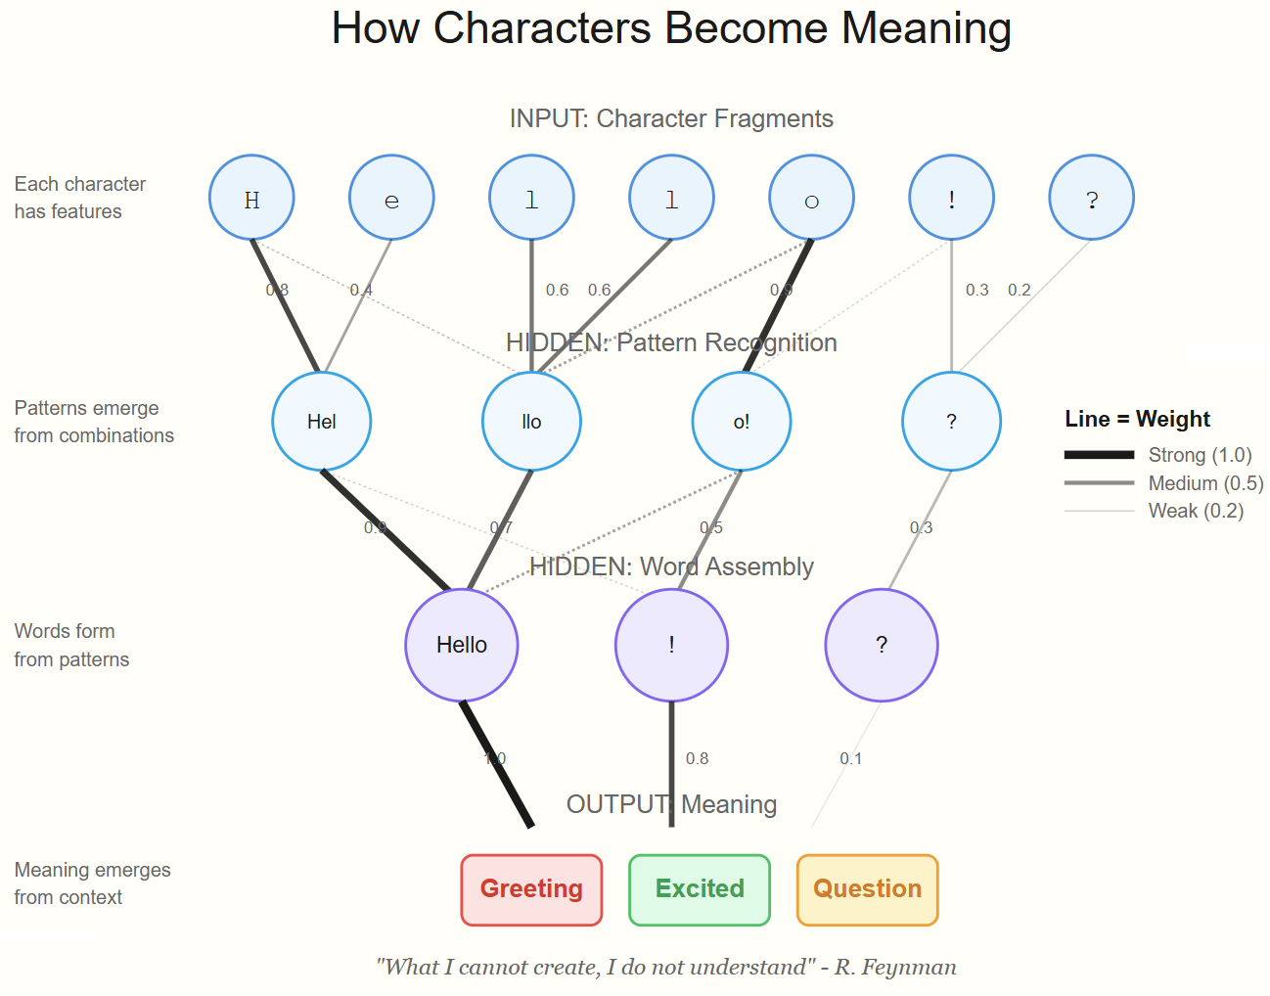
Neural Network
Notes:
Image credit: Tim + Claude AI

Slide 23
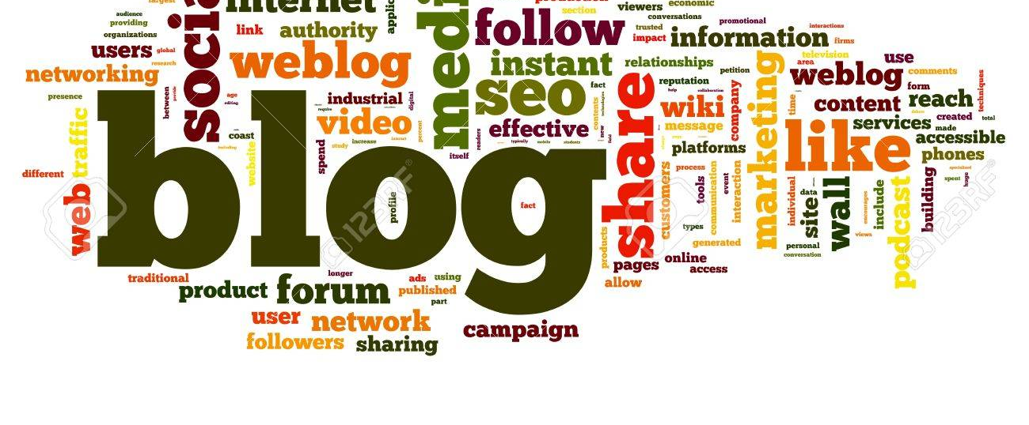
Neural Network
go.techtrainertim.com/cloud

Slide 24
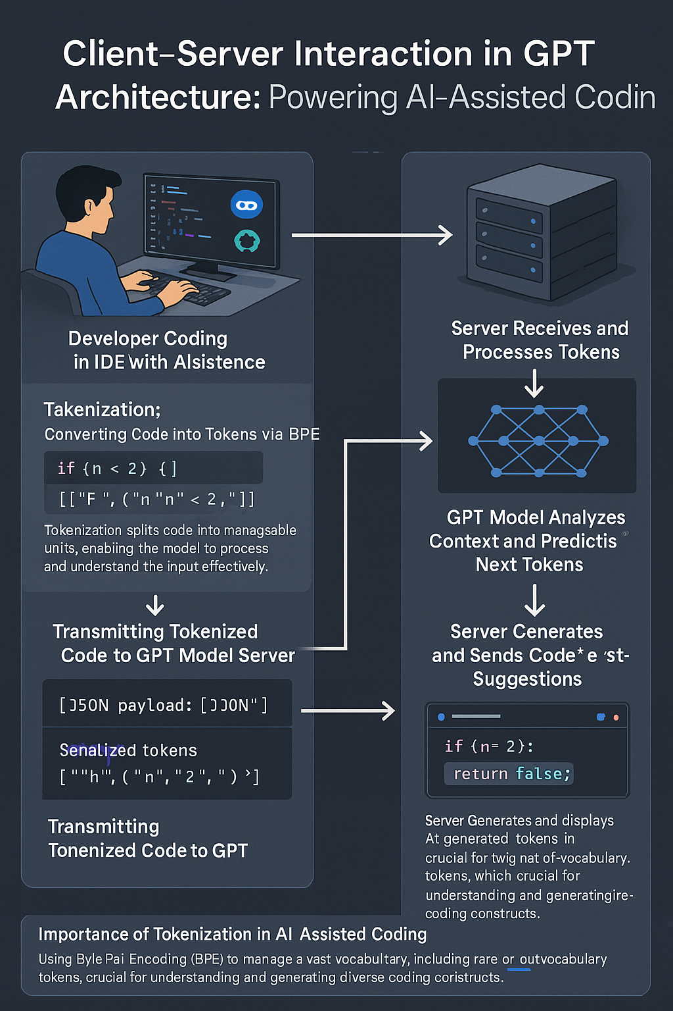
GPT Basic Architecture
OpenAI GPT 4o Image Generation
Multimodal generative AI
Two ways to improve model:
Fine tuning
Retrieval Augmented Generation (RAG)

Slide 25
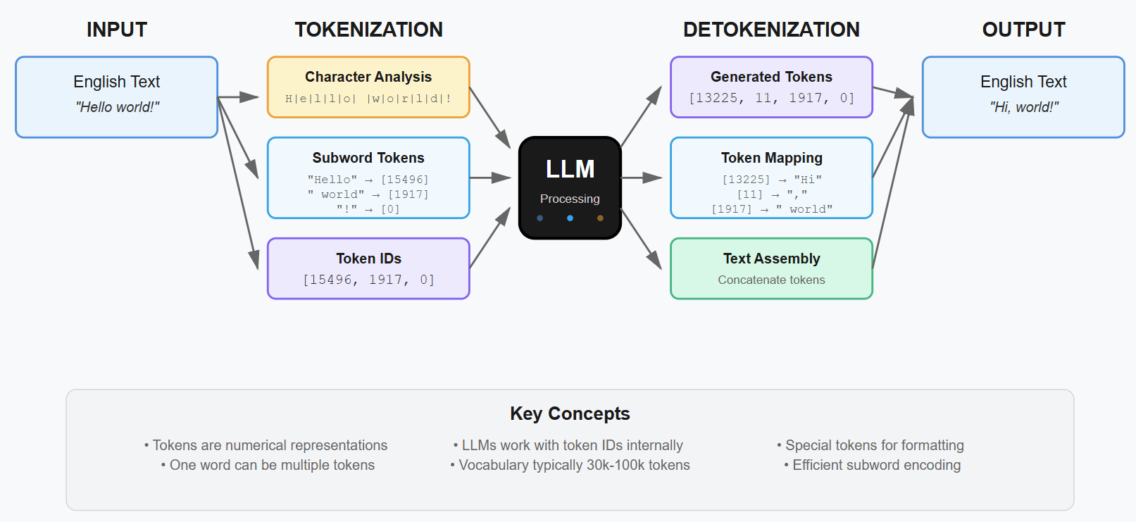
Tokenization Process in LLMs

Slide 26

Context Length

Slide 27
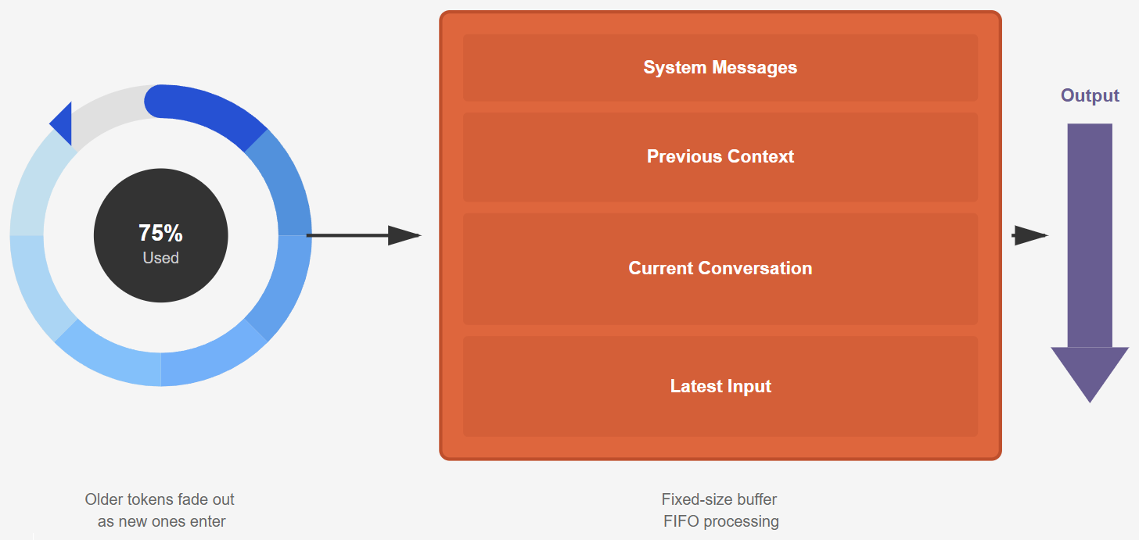
Context Window
Notes:
Illustration credit: Tim

Slide 28
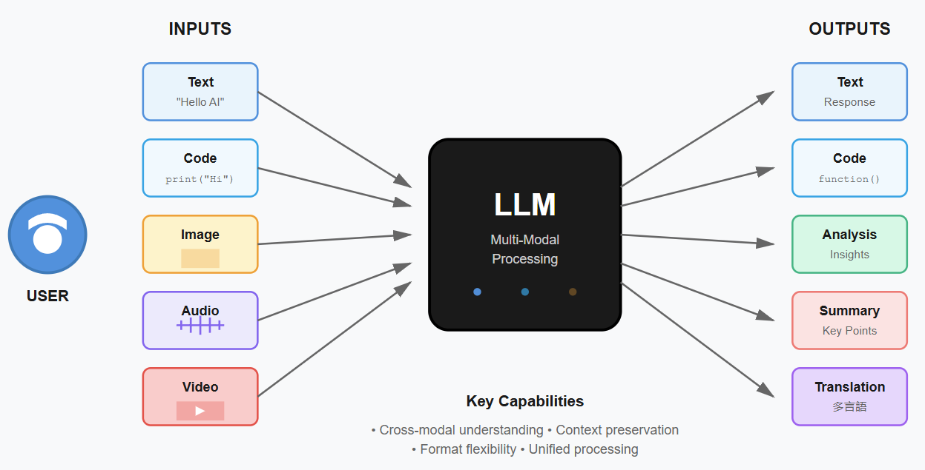
LLM Multi-Modal Processing
Notes:
Image credit: Tim + Claude AI

Slide 29
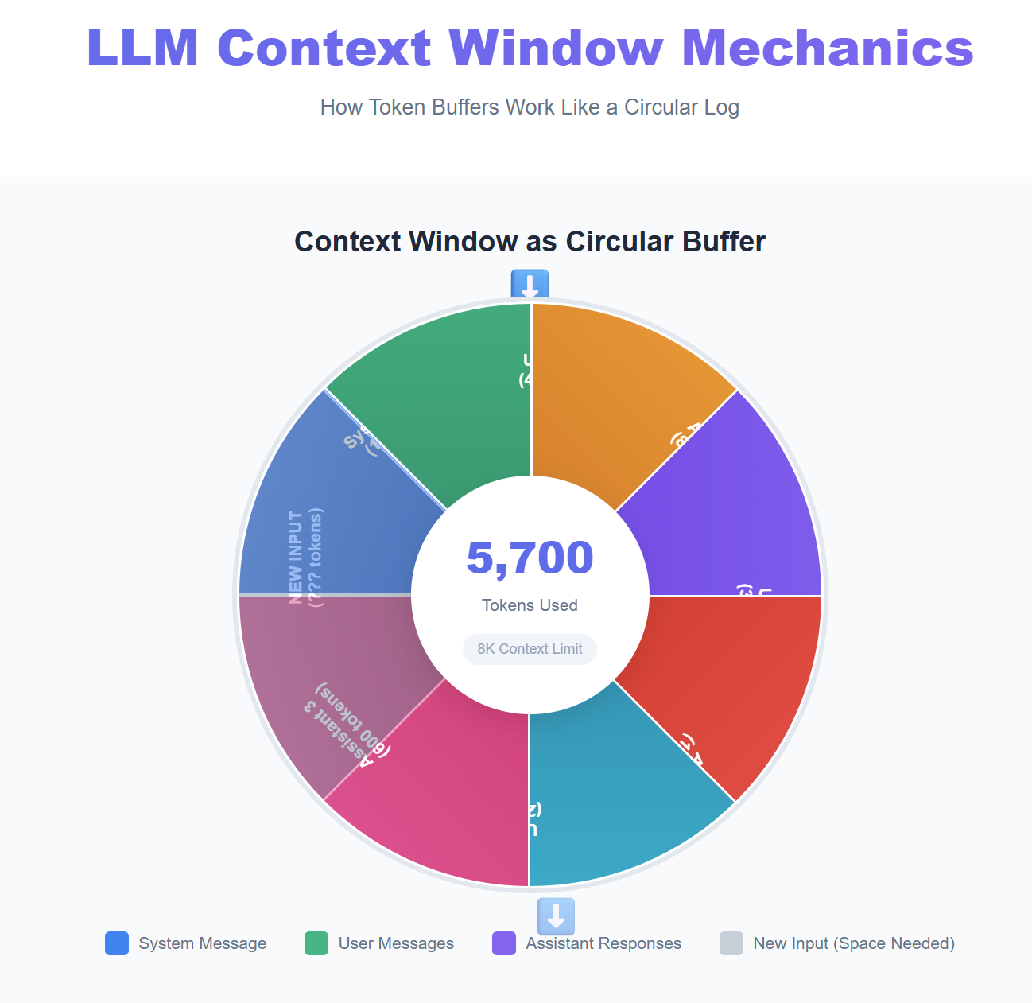
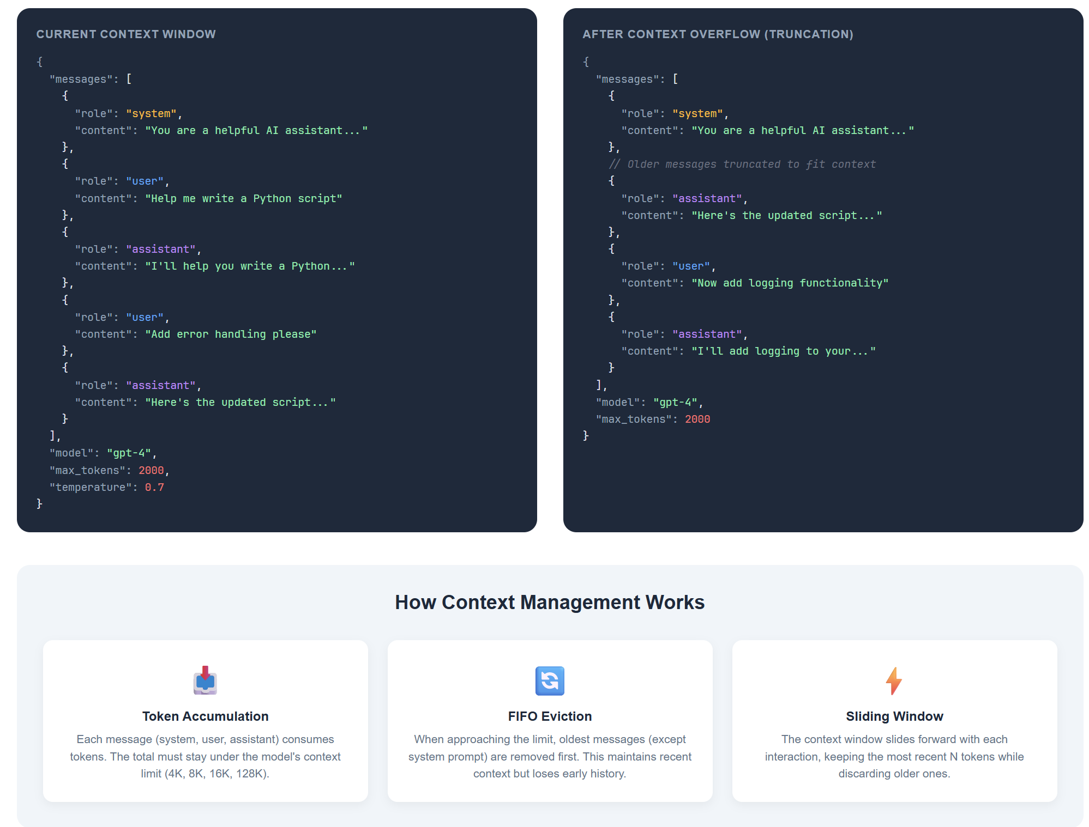

Slide 30
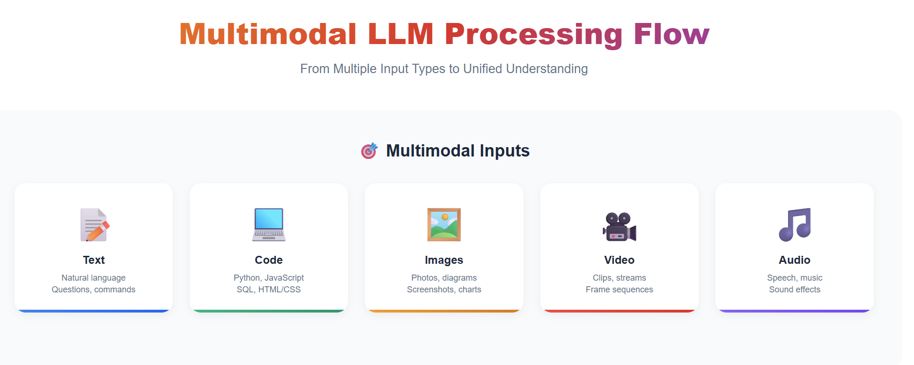
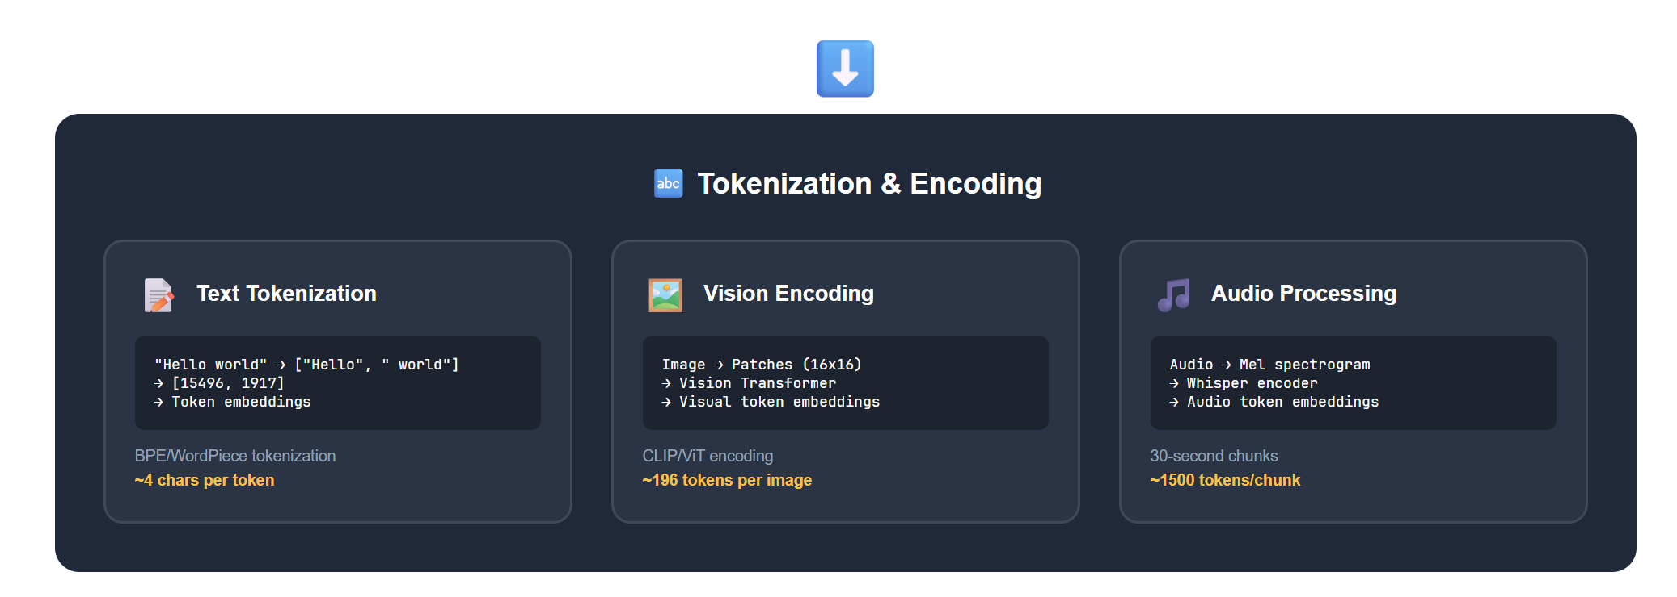
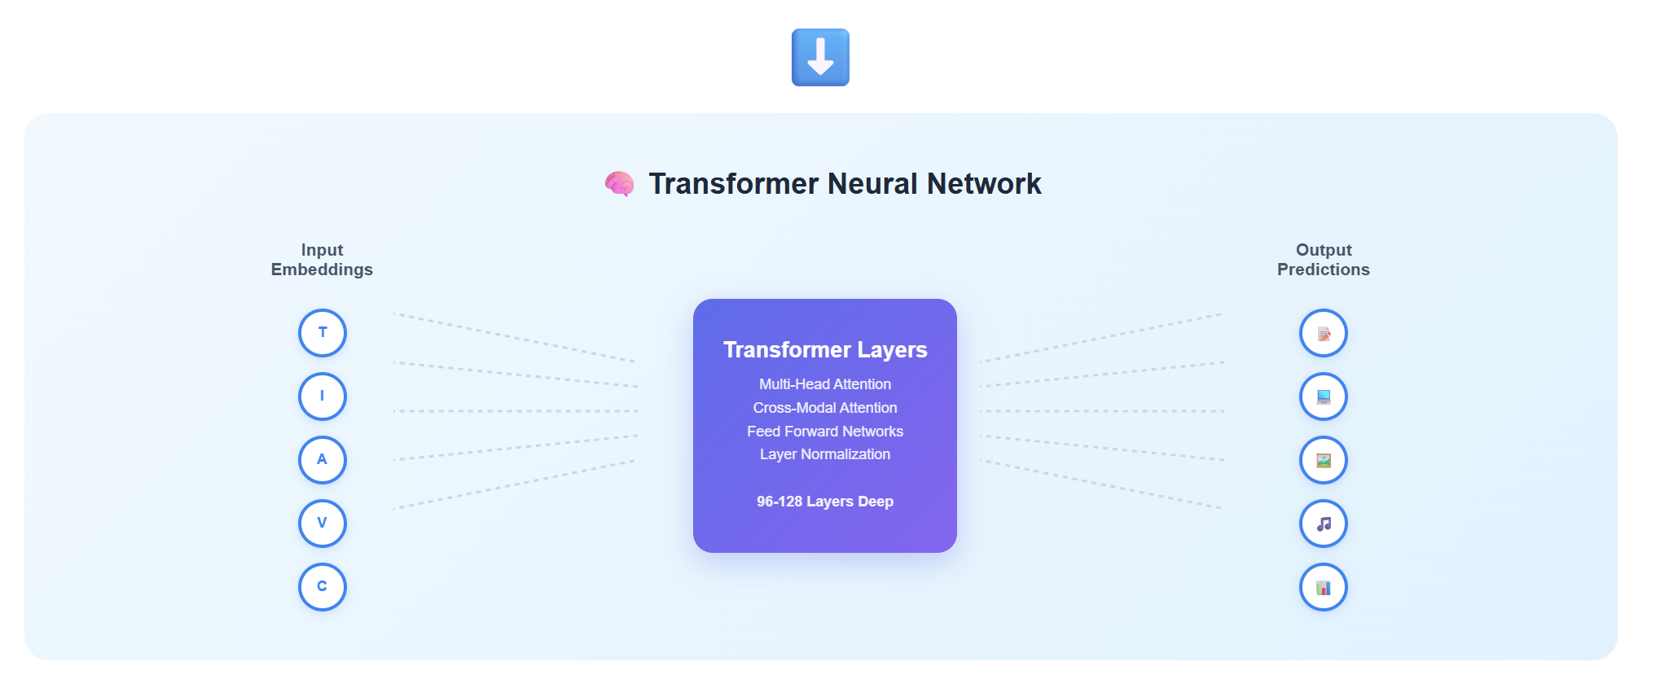
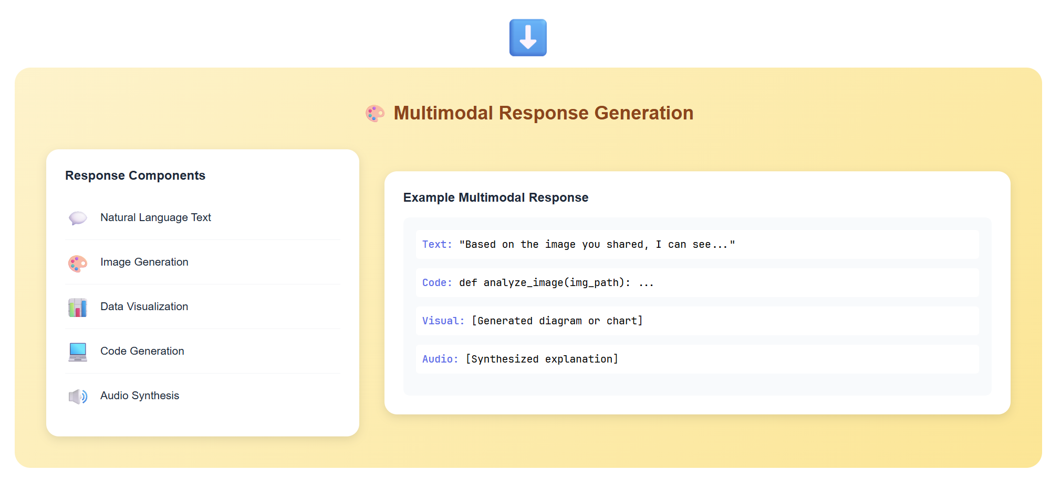

Slide 31
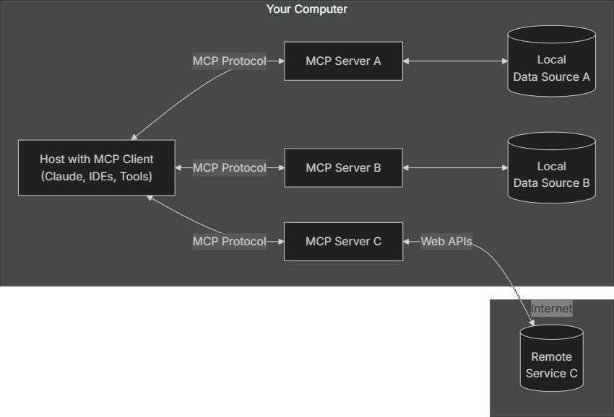
Anthropic Model Context Protocol (MCP)
modelcontextprotocol.io

Slide 32
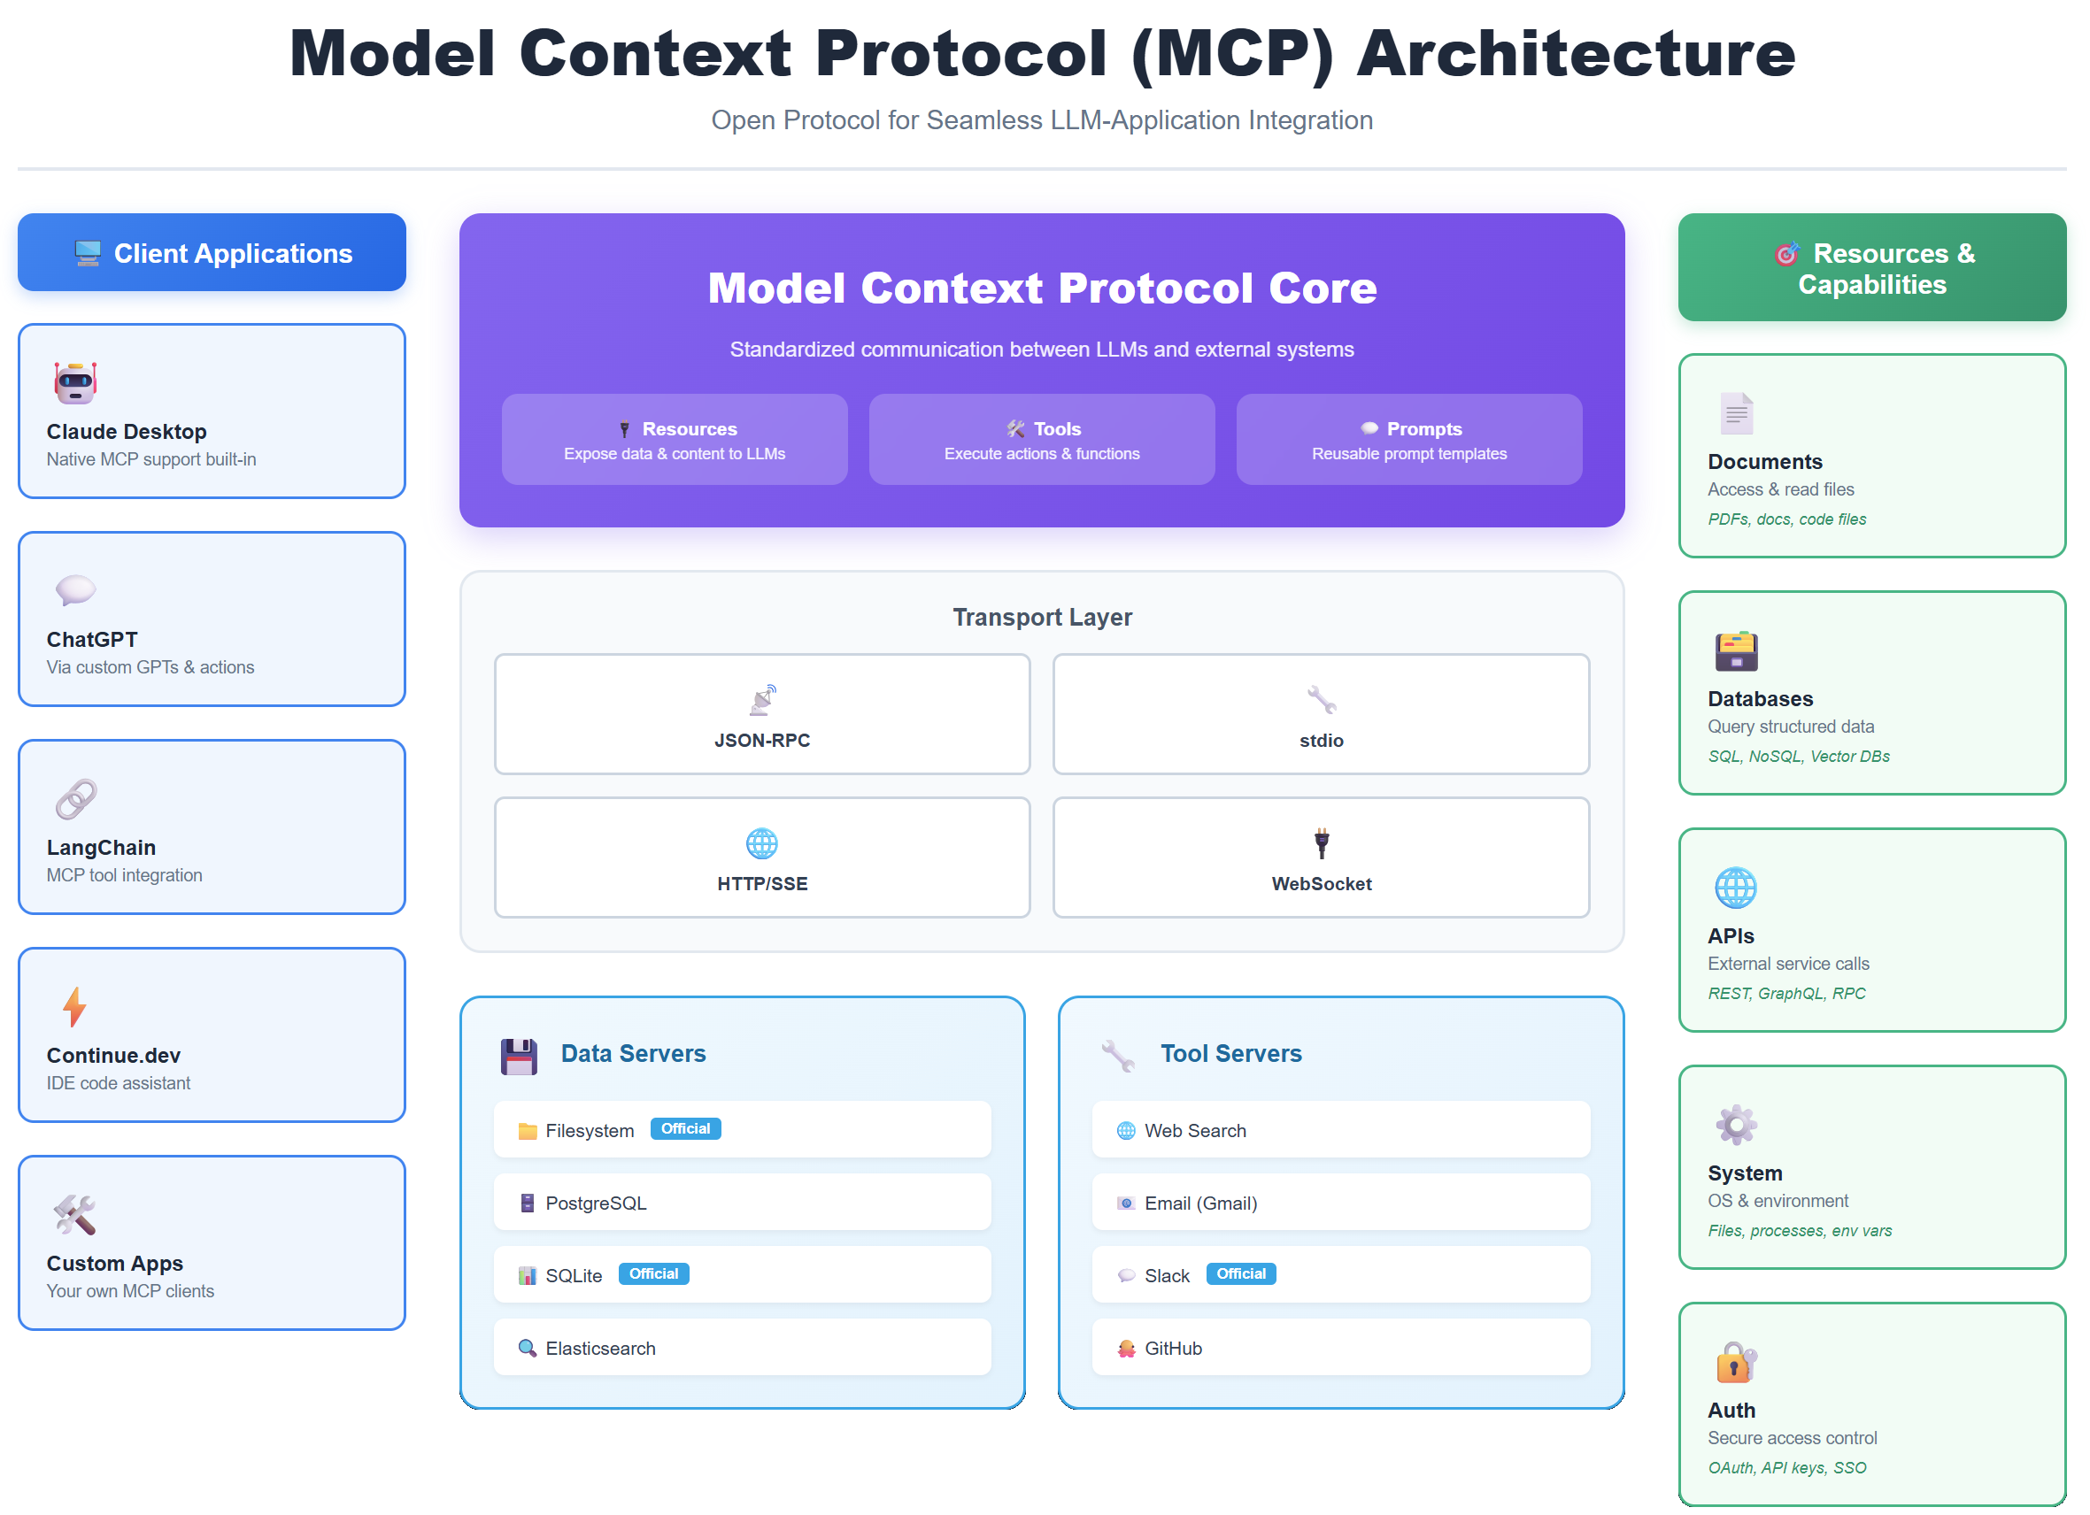

Slide 33
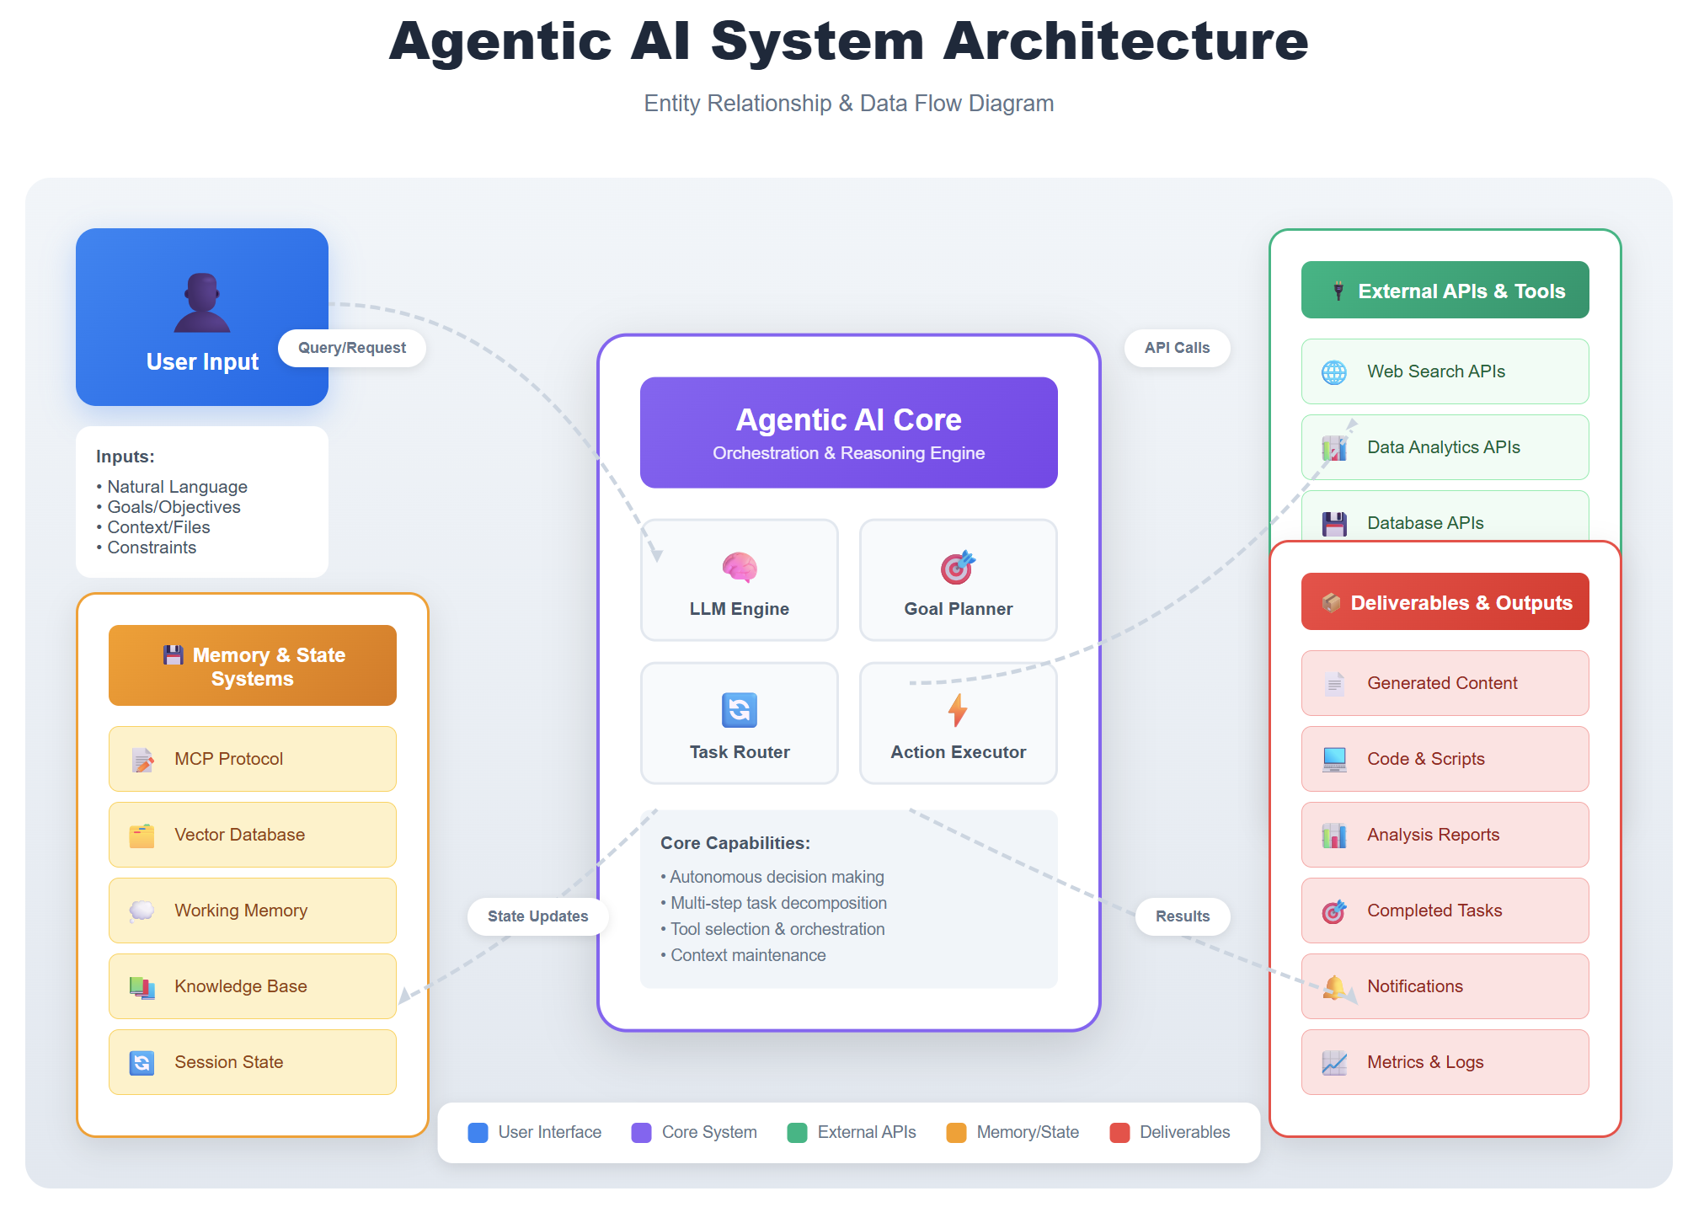

Slide 34
What is Artificial Intelligence (AI)?
📌 Artificial Intelligence (AI) enables machines to mimic human intelligence—learning, sensing, and making decisions.
💡 You interact with AI daily without realizing it:
✅ Voice assistants understanding questions
✅ Personalized movie recommendations
✅ Instant text translation
🛠️ AI isn’t magic—it’s a practical technology already in apps you use.

Slide 35
AI workloads = Different types of tasks
AI workloads = common AI-powered tasks like vision, language, and decision-making.
Key types: Content moderation, computer vision, NLP, knowledge mining, document intelligence, and generative AI.
Azure AI services simplify each workload with prebuilt models and APIs.
Examples: Azure AI Vision (image analysis), Azure AI Language (text processing), Azure OpenAI Service (content generation).

Slide 36
Content moderation and personalization
Content Moderation (Azure AI Content Safety)
Detects harmful content (profanity, hate speech, explicit images)
Used in gaming, social media, and e-commerce to ensure safety
Example: Contoso Games filters offensive messages in multiplayer chat
Personalization (Azure AI Personalizer)
AI learns user behavior and recommends products, services, or content
Example: Fabrikam News suggests articles based on reading habits
Notes:
🎬 Screencast Demo Idea: ➡️ Use Azure AI Content Safety to analyze text and detect inappropriate content.
Go to Azure AI Content Safety in Azure Portal.
Enter sample text (e.g., "You are a [offensive word]!") and see the moderation score.
Show how developers can integrate this into apps using API calls.

Slide 37
Computer vision solutions with Azure
Azure AI Vision (formerly Azure Computer Vision)
Analyze images & videos for objects, faces, or text
OCR (Optical Character Recognition) extracts text from scanned docs
Example: Fabrikam Manufacturing automates defect detection on an assembly line
Notes:
🎬 Screencast Demo Idea: ➡️ Use Azure AI Vision to extract text from an image.
Upload an image with text (e.g., a receipt) into Azure AI Vision’s OCR tool.
Show extracted text in JSON output.
Explain how businesses use this for automating document processing.

Slide 38
Harness the power of NLP
Text Analytics (Azure AI Language)
Sentiment analysis (positive/negative/neutral feedback detection)
Key phrase & entity extraction (names, locations, products from text)
Example: A. Datum uses AI to summarize customer complaints
Conversational AI (Azure AI Bot Service)
Enables AI-powered chatbots for customer support
Example: Woodgrove Bank chatbot handles FAQs in multiple languages
Notes:
🎬 Screencast Demo Idea: ➡️ Analyze sentiment using Azure AI Language
Enter a customer review in Azure AI Language.
Show real-time sentiment analysis results.
Explain how businesses use this to track customer satisfaction.

Slide 39
Find hidden insights with knowledge mining
Azure AI Search (formerly Azure Cognitive Search)
Extracts key insights from documents, emails, PDFs
Builds smart search for internal and customer-facing applications
Example: Blue Yonder Airlines mines customer feedback for service improvements
Notes:
🎬 Screencast Demo Idea: ➡️ Use Azure Cognitive Search to index a set of documents.
Upload sample documents (PDFs or emails) into Cognitive Search.
Run a query (e.g., "Find all documents mentioning 'delayed flights'").
Show how AI extracts relevant insights automatically.

Slide 40
Analyze and extract info from documents
Azure AI Document Intelligence (formerly Azure Form Recognizer)
Extracts data from invoices, receipts, contracts, and business forms
Custom model training for specific document formats
Example: Adventure Works automates mortgage application processing
Notes:
🎬 Screencast Demo Idea: ➡️ Use Azure AI Document Intelligence to extract fields from an invoice.
Upload a sample invoice to Document Intelligence.
Show how AI extracts "Total Amount," "Invoice Number," etc.
Demonstrate how structured data can be sent to an accounting system.

Slide 41
The power of generative AI models
Azure OpenAI Service (GPT models for text, DALL-E for images)
AI-generated text, code, and images
Content summarization, creative writing, chatbot responses
Example: Wingtip Toys generates dynamic product descriptions for e-commerce
Notes:
🎬 Screencast Demo Idea: ➡️ Use Azure OpenAI to generate a product description.
Input “Smartwatch with heart rate tracking and 7-day battery” in OpenAI’s playground.
Generate a detailed product description.
Show variations and explain how businesses automate content creation.

Slide 42
Case Study: Tailwind Traders Transforms with Azure AI
Challenge: Improve customer experience, personalize offerings, streamline operations
Solution:
✅ Content Moderation – Filters harmful user content (Azure AI Content Safety)
✅ Personalization – Suggests relevant products based on behavior (Azure Personalizer)
✅ Computer Vision – Automates product quality inspections (Azure AI Vision)
✅ Conversational AI – AI-powered chatbot for 24/7 customer support (Azure AI Language + Azure AI Bot Service)
Results:
✔️ Increased customer satisfaction and loyalty
✔️ Improved operational efficiency
Notes:
🎬 Screencast Demo Idea: ➡️ Live demo of a chatbot using Azure Bot Service
Create a basic FAQ bot in Azure Bot Service.
Deploy it to Teams or a web chat.
Show it answering a sample customer query.

Slide 43
What is Responsible AI?
📌 AI must be trustworthy, ethical, and beneficial to all.
✅ Prevents bias, errors, and unfair decisions
✅ Ensures safety, security, and user privacy
✅ Builds trust and transparency with stakeholders
✅ Microsoft follows six key Responsible AI principles (fairness, reliability, privacy, inclusiveness, transparency, accountability)
Notes:
🎬 Screencast Demo Idea: ➡ Show AI Foundry’s Responsible AI features (dashboard, built-in fairness and safety checks during AI development).

Slide 44
Fairness in AI solutions
📌 Prevent AI from treating people unfairly.
✅ Detect & mitigate bias in datasets and models
✅ Test for fairness across demographics (e.g., gender, race, age)
✅ Use bias-reduction techniques (data balancing, Fairlearn toolkit)
✅ Example: Contoso Bank's loan AI ensures fair approvals for all applicants
Notes:
🎬 Screencast Demo Idea: ➡ Use Azure’s Responsible AI Dashboard to show fairness metrics in a model (e.g., different approval rates for two groups).

Slide 45
AI must be reliable and safe
📌 AI must perform consistently & safely.
✅ Test under real-world conditions (stress-test AI for failures)
✅ Build fail-safes & fallback mechanisms (e.g., if AI misfires, human override)
✅ Monitor AI in production (detect anomalies, retrain models if needed)
✅ Example: Fabrikam's self-driving AI prioritizes safety in all weather conditions
Notes:
🎬 Screencast Demo Idea: ➡ Show AI Content Safety filtering harmful AI outputs in Azure AI Studio.

Slide 46
Privacy & security in AI solutions
📌 Protect user data & ensure secure AI operations.
✅ Follow laws (GDPR, HIPAA) to safeguard privacy
✅ Encrypt sensitive data & limit retention
✅ Obtain user consent before collecting data
✅ Example: Woodgrove Health's AI system encrypts all patient data for privacy
Notes:
🎬 Screencast Demo Idea: ➡ Show Azure AI Content Safety flagging personally identifiable information (PII) in text processing.

Slide 47
AI for Everyone
📌 AI must work well for diverse users.
✅ Use inclusive datasets (various accents, cultures, abilities)
✅ Test with real users from different backgrounds
✅ Include accessibility features (text-to-speech, alt-text, captions)
✅ Example: Northwind Traders’ speech AI supports multiple dialects & disabilities
Notes:
🎬 Screencast Demo Idea: ➡ Show Azure Immersive Reader translating and reading text aloud for accessibility.

Slide 48
Transparency in AI
📌 Users must understand AI decisions.
✅ Use Explainable AI (LIME, SHAP) to clarify AI outputs
✅ Document model data & decision logic
✅ Show users why AI made a choice (not a black box)
✅ Example: Proseware’s financial AI explains why a loan was approved/denied
Notes:
🎬 Screencast Demo Idea: ➡ Show Azure Responsible AI Dashboard explaining model decisions (SHAP feature importance chart).

Slide 49
AI needs human oversight
📌 People must take responsibility for AI outcomes.
✅ Assign accountability (AI ethics committee, governance team)
✅ Monitor AI & fix unintended consequences
✅ Log decisions for audits (track AI choices & actions)
✅ Example: Wingtip Toys’ AI ethics board oversees toy recommendations
Notes:
🎬 Screencast Demo Idea: ➡ Show Azure AI monitoring tools flagging anomalies in model behavior for human review.

Slide 50
Case Study: Wingtip Toys & Responsible AI
📌 Wingtip Toys ensures ethical AI-powered recommendations
✅ Fairness: Diverse training data, bias testing
✅ Safety: Filters prevent harmful suggestions
✅ Privacy: Compliance with GDPR, explicit user consent
✅ Transparency: Explains why AI recommends certain toys
Notes:
🎬 Screencast Demo Idea: ➡ Simulate AI model monitoring in Azure ML – show alerts for biased or unsafe outputs.

Slide 51
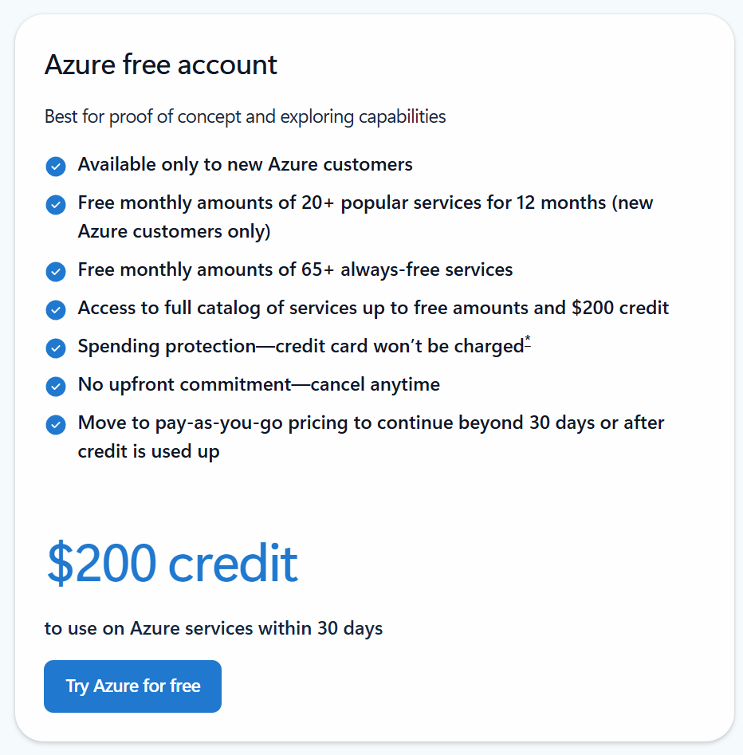
The importance of the Azure free account
go.techtrainertim.com/free
Notes:
🎬 Screencast Demo Idea: ➡️ Use Azure OpenAI to generate a product description.
Input “Smartwatch with heart rate tracking and 7-day battery” in OpenAI’s playground.
Generate a detailed product description.
Show variations and explain how businesses automate content creation.

Slide 52
What is Machine Learning (ML)?
📌 ML enables computers to learn from data & make predictions.
✅ Finds patterns – Learns from past data to improve over time
✅ Makes predictions – Forecasts sales, detects fraud, recognizes images
✅ Automates decisions – Helps businesses act on insights faster
✅ Powers AI applications – Chatbots, recommendation systems, self-driving tech
Notes:
🎬 Screencast Demo: ➡ Use Azure ML Studio’s AutoML to train a simple prediction model & show how it improves with more data.

Slide 53
Machine Learning (ML) lifecycle
Notes:
I generated the image with my prompt in my personal ChatGPT account using their latest image-gen model. Did that on Wed, 3/26/2025 at 3pm Central or thereabouts.

Slide 54
Identify regression ML scenarios
📌 Predict continuous values from past data.
✅ Forecast trends – e.g., sales, stock prices, revenue
✅ Estimate numeric values – e.g., house price based on features
✅ Predict equipment lifespan – optimize maintenance schedules
✅ Example: Fabrikam forecasts product demand to optimize inventory
Notes:
🎬 Screencast Demo: ➡ Use Azure ML Studio AutoML to train a regression model predicting sales. Show predictions vs. actuals in Azure ML UI.

Slide 55
Categorize data with classification
📌 Categorize data into predefined labels (yes/no, A/B/C).
✅ Fraud detection – flag legitimate vs. fraudulent transactions
✅ Spam filtering – classify emails as spam or not spam
✅ Medical diagnosis – detect diseases based on symptoms
✅ Example: Contoso Bank predicts loan default risk (low vs. high)
Notes:
🎬 Screencast Demo: ➡ Train a classification model in Azure ML Studio (e.g., loan risk predictor). Show accuracy metrics & test predictions via Azure ML UI.

Slide 56
Identify clustering ML scenarios
📌 Find hidden patterns in data (without labels).
✅ Segment customers – group shoppers by buying habits for marketing
✅ Detect anomalies – spot unusual network traffic for security
✅ Organize data – cluster similar images, products, or documents
✅ Example: Northwind Traders groups customers for personalized offers
Notes:
🎬 Screencast Demo: ➡ Use Azure ML Designer to apply K-means clustering on customer data. Show visual clusters of different shopper segments.

Slide 57
Identify features of Deep Learning techniques
📌 Neural networks power complex AI tasks.
✅ Excels at images & language – e.g., face recognition, chatbots
✅ Learns from unstructured data – text, speech, video
✅ Drives AI applications – language translation, visual search, automation
✅ Example: Wingtip Toys uses GPT deep learning hosted in Azure OpenAI Service for image-based product search
Notes:
🎬 Screencast Demo: ➡ Show Azure AI Studio Vision recognizing product images or use Azure OpenAI Chat to generate human-like responses.

Slide 58
Case Study: Proseware Uses ML for Data Insights
📌 How ML improves business decisions.
✅ Regression: Predicted revenue trends
✅ Classification: Detected fraudulent transactions
✅ Clustering: Segmented customers for targeted marketing
✅ Deep Learning: AI chatbot for 24/7 customer support
Notes:
🎬 Screencast Demo: ➡ Deploy a trained ML model in Azure ML Studio and test it with sample inputs. Show how a chatbot AI answers customer questions in Azure AI Studio.

Slide 59
Identify features and labels in an ML dataset
📌 Features = Inputs | Labels = Predictions
✅ Features (Independent Variables): The input data (e.g., square footage, number of bedrooms for house pricing)
✅ Labels (Target Variables): The value AI predicts (e.g., house sale price)
✅ Structured vs. Unstructured Data: Features can be numerical, categorical, or text-based
✅ Example: Adventure Works uses features like workout frequency & diet to predict fitness progress
Notes:
🎬 Screencast Demo: ➡ Use Azure ML Studio’s Data Labeling tool to define features & labels in a dataset (e.g., tagging features in a structured dataset).

Slide 60
Training vs. validation datasets in ML
📌 Train AI with one dataset, test with another.
✅ Training Dataset: Used to teach the model patterns (typically 70-80% of data)
✅ Validation Dataset: Evaluates performance, fine-tunes model (20-30% of data)
✅ Avoid Overfitting: A model must generalize beyond training data
✅ Example: Contoso splits medical records 80/20 to train & validate a disease prediction AI
Notes:
🎬 Screencast Demo: ➡ Use Azure ML Studio to split data into training & validation sets, then visualize results in the UI.

Slide 61
Capabilities of Automated ML (AutoML)
📌 No-code AI: Let AutoML pick the best model.
✅ Automates ML model selection & hyperparameter tuning
✅ Great for non-data scientists or fast experimentation
✅ Supports regression, classification, & forecasting models
✅ Example: Fabrikam detects fraudulent insurance claims in minutes using AutoML
Notes:
🎬 Screencast Demo: ➡ Run an AutoML experiment in Azure AI Studio to compare models & deploy the best one.

Slide 62
Data & compute services for ML in Azure
📌 Powerful tools for managing ML workloads.
✅ Azure Databricks: Scalable Spark-based analytics (big data prep)
✅ Azure Synapse: Data warehousing & predictive analytics
✅ Azure ML Compute: Auto-scales training workloads
✅ Example: Proseware combines Synapse & Databricks to process vast retail sales data for ML predictions
Notes:
🎬 Screencast Demo: ➡ Show Databricks running a simple Python script that analyzes & preps data for ML.

Slide 63
Model management & deployment in Azure ML
📌 Deploy, monitor & improve ML models.
✅ Model Registry: Track versions of trained models
✅ Deploy as Web Services: Host models as REST APIs
✅ Monitor Performance: Detect model drift, retrain as needed
✅ Example: Wingtip Toys deploys a recommendation AI as an API for its e-commerce site
Notes:
🎬 Screencast Demo: ➡ Deploy a model in Azure ML Studio & test predictions via REST API.

Slide 64
Case Study: Northwind Streamlines Ops with Azure ML
📌 How Northwind optimizes business with ML.
✅ Data Prep: Used Azure Databricks for data cleaning
✅ Model Training: Used AutoML for demand forecasting
✅ Compute Scaling: Leveraged Azure ML Compute
✅ Deployment: Integrated models with business apps
Notes:
🎬 Screencast Demo: ➡ Show ML model deployed as an endpoint & tested via an app integration.

Slide 65
Classify images by category using AI
✅ Assign images to predefined labels (e.g., dog, cat, tree)
✅ Medical imaging: AI detects diseases in X-rays
✅ Manufacturing: Sorts products on an assembly line
✅ Example: Contoso Games classifies user screenshots to detect which game is being played
Notes:
🎬 Screencast Demo: ➡ Use Azure AI Vision to classify images into categories (e.g., upload animal photos and let AI assign labels).

Slide 66
Find & track objects within images
✅ Draw bounding boxes around detected objects
✅ Count objects (e.g., cars in a parking lot)
✅ Detect manufacturing defects (quality control in factories)
✅ Example: Fabrikam tracks inventory by detecting product boxes in warehouse images
Notes:
🎬 Screencast Demo: ➡ Use Azure AI Vision’s object detection to detect and count items in an image (e.g., counting apples in a fruit stand photo).

Slide 67
Extract & digitize text from images
✅ Convert scanned docs into searchable text (PDFs, contracts)
✅ Read street signs & license plates from images
✅ Process handwritten forms into digital data
✅ Example: Wingtip Toys digitizes old product catalogs with OCR for online
Notes:
🎬 Screencast Demo: ➡ Use Azure AI Vision OCR to extract text from a scanned receipt.

Slide 68
Detect & analyze faces in images or video
✅ Find & count faces in photos or surveillance footage
✅ Estimate age, gender, & emotions from facial data
✅ Use face recognition for security access
✅ Example: Northwind Traders personalizes in-store ads by estimating customer demographics from facial analysis
Notes:
🎬 Screencast Demo: ➡ Use Azure AI Face to detect faces & estimate emotions from an uploaded image.

Slide 69
Prebuilt & customizable AI for image analysis
✅ Analyze images: Generate tags, descriptions, & objects
✅ Recognize celebrities & landmarks
✅ Extract text (OCR) & moderate content
✅ Example: Proseware auto-tags product images to improve e-commerce searchability
Notes:
🎬 Screencast Demo: ➡ Use Azure AI Vision’s Analyze Image API to describe an uploaded photo.

Slide 70
AI-powered face detection & recognition
✅ Detect & track faces with high accuracy
✅ Analyze attributes: Age, gender, emotion, accessories (e.g., glasses)
✅ Enable secure authentication using facial recognition
✅ Example: Contoso Bank verifies customer identity using Azure Face API
Notes:
🎬 Screencast Demo: ➡ Use Azure AI Face to detect & analyze facial attributes in a sample photo.

Slide 71
Case Study: Northwind Uses AI Vision for Search
📌 Northwind automates product image tagging.
✅ Vision API analyzes uploaded product images
✅ Object detection identifies product types
✅ OCR extracts text from packaging labels
✅ Face detection personalizes user experience

Slide 72
Extract important keywords from text
✅ Summarize long documents by pulling key themes
✅ Analyze customer feedback for product insights
✅ Identify trending topics in social media discussions
✅ Example: Northwind Traders uses key phrase extraction to analyze product reviews & identify customer preferences
Notes:
🎬 Screencast Demo: ➡ Use Azure AI Language’s Key Phrase Extraction API to analyze customer reviews and see what words appear most frequently.

Slide 73
Detect important entities in text
✅ Recognize people, companies, places, & dates from unstructured text
✅ Categorize key terms into predefined groups (e.g., financial, medical)
✅ Improve search relevance by linking entities to structured data
✅ Example: Proseware analyzes legal contracts to extract key clauses & entities (e.g., company names, contract dates).
Notes:
🎬 Screencast Demo: ➡ Use Azure AI Language’s Entity Recognition API to process a news article and identify all locations, names, and organizations.

Slide 74
Determine if text is positive, negative, or neutral
✅ Analyze customer sentiment in product reviews & social media
✅ Prioritize customer support requests based on urgency & tone
✅ Monitor brand reputation in real-time
✅ Example: Contoso Bank flags negative customer reviews to escalate urgent complaints.
Notes:
🎬 Screencast Demo: ➡ Use Azure AI Language Sentiment Analysis to process tweets about a company and visualize the sentiment score (positive/neutral/negative).

Slide 75
Generate human-like text & understand context
✅ Power chatbots & virtual assistants
✅ Summarize documents automatically
✅ Generate creative text for content creation
✅ Example: Wingtip Toys’ chatbot uses language modeling to provide conversational product recommendations.
Notes:
🎬 Screencast Demo: ➡ Use Azure OpenAI’s GPT model to generate a response to a customer’s question in a chatbot setting.

Slide 76
Convert speech to text & vice versa
✅ Transcribe audio calls or voice commands
✅ Enable hands-free interactions in applications
✅ Power virtual assistants & voice interfaces
✅ Example: Fabrikam allows users to search products in its mobile app using voice commands.
Notes:
🎬 Screencast Demo: ➡ Use Azure AI Speech-to-Text to transcribe a recorded customer service call in real time.

Slide 77
Convert text between languages using AI
✅ Break language barriers in real-time communication
✅ Localize content for international users
✅ Translate customer inquiries for global support teams
✅ Example: Woodgrove Travel offers its website in multiple languages using Azure AI Translation.
Notes:
🎬 Screencast Demo: ➡ Use Azure AI Translator to instantly convert a customer email from Spanish to English.

Slide 78
Comprehensive NLP services from Azure
✅ Pre-built models for text analytics (sentiment, key phrases, entities)
✅ Supports chatbot building (QnA Maker, Conversational AI)
✅ Custom models for domain-specific text analysis
✅ Example: Northwind Traders’ chatbot uses AI Language to analyze customer support questions.
Notes:
🎬 Screencast Demo: ➡ Show Azure AI Language Studio UI and explore the different NLP models available.

Slide 79
Advanced speech recognition & synthesis
✅ Speech-to-text & text-to-speech conversion
✅ Customizable voices & accents
✅ Speaker identification for security & personalization
✅ Example: Contoso Games integrates Azure AI Speech to allow gamers to issue voice commands.
Notes:
🎬 Screencast Demo: ➡ Show Azure AI Speech synthesizing natural-sounding text into voice using different accents.

Slide 80
Case Study: Contoso Health Streamlines Patient Consultations with AI
✅ Speech-to-Text: Converts doctor-patient consultations into transcribed notes
✅ Text Analytics: Extracts medical conditions & symptoms from transcripts
✅ Knowledge Mining: Searches past consultations for similar cases
Notes:
🎬 Screencast Demo: ➡ Use Azure Speech-to-Text to transcribe a short medical consultation.

Slide 81
AI that creates new content from learned patterns
✅ Generates text, images, code, and audio from patterns in data
✅ Trained on massive datasets to mimic styles, structures, and creativity
✅ Includes Large Language Models (LLMs) (e.g., GPT-4) & image generators (e.g., DALL·E)
✅ Example: Proseware uses generative AI to generate product descriptions, saving writers time.
Notes:
🎬 Screencast Demo: ➡ Use Azure OpenAI GPT-4 to generate a marketing product description based on a short prompt.

Slide 82
Generative AI (LLM) architecture

Slide 83
Where generative AI is transforming industries
✅ Content Creation: AI writes blogs, marketing copy, and social media posts
✅ Image Generation: Create custom product visuals & artwork
✅ Writing Assistance: Summarize text, improve grammar, and translate languages
✅ Code Generation: Suggest, complete, and debug code for developers
✅ Example: Fabrikam uses AI-generated code to accelerate software development.
Notes:
🎬 Screencast Demo: ➡ Use Azure OpenAI Codex to generate a Python function from a natural language prompt.

Slide 84
Balancing innovation with ethical AI practices
✅ Bias & Fairness: Models inherit biases from training data—monitor & mitigate them
✅ Misinformation Risks: AI can create misleading text, deepfakes, and synthetic media
✅ Intellectual Property (IP): Address legal concerns around AI-generated content ownership
✅ Example: Wingtip Toys carefully reviews AI-generated images to prevent brand inconsistencies & bias.
Notes:
🎬 Screencast Demo: ➡ Use Azure AI Content Safety to analyze AI-generated text/images for potential bias or policy violations.

Slide 85
Case Study: Northwind Traders Leverages Generative AI for Marketing Innovation
📌 Scaling content creation with AI while maintaining ethical standards.
✅ Challenge: Create diverse, engaging marketing visuals at low cost
✅ Solution: AI-generated images based on text prompts + manual review for branding & ethics
✅ Results: Scaled marketing campaigns while ensuring responsible AI use
Notes:
🎬 Screencast Demo: ➡ Use Azure OpenAI DALL·E to generate a product marketing image based on a text prompt.

Slide 86
Generate high-quality text with GPT models
✅ Writes blog posts, marketing copy, and summaries
✅ Translates languages & answers complex questions
✅ Customizable for chatbots, customer service, and content creation
✅ Example: Wingtip Toys generates playful product descriptions using Azure OpenAI GPT-4o.
Notes:
🎬 Screencast Demo: ➡ Use Azure OpenAI GPT-4 to generate a creative product description from a short prompt.

Slide 87
Accelerate development with GPT
✅ Generates Python, JavaScript, and other code from plain-language prompts
✅ Explains complex code & assists with debugging
✅ Boosts developer productivity with boilerplate generation
✅ Example: Fabrikam developers use Azure OpenAI Service Codex model to automate repetitive coding tasks & reduce errors.
Notes:
🎬 Screencast Demo: ➡ Use Azure OpenAI Codex to generate a Python function from a natural language prompt.

Slide 88
Create original images with DALL-E
✅ Generates unique artwork & photorealistic images from text
✅ Combines styles, concepts & objects seamlessly
✅ Used in marketing, game design & content creation
✅ Example: Contoso Games generates concept art & in-game assets using DALL-E.
Notes:
🎬 Screencast Demo: ➡ Use Azure OpenAI DALL·E to generate a unique game character from a text prompt.

Slide 89
Create original images with DALL-E
✅ Challenge: Create diverse, engaging marketing visuals cost-effectively
✅ Solution: AI-generated images using DALL·E with branding safeguards
✅ Results: Faster campaign development with consistent, high-quality visuals
Notes:
🎬 Screencast Demo: ➡ Show how Northwind creates a branded AI-generated ad image using Azure OpenAI DALL·E.

